Slide 1
An-Najah National University
Faculty of Medicine
Department of Physiology
Anatomy and Physiology 1
7102101
Instructor: Heba Salah
Chapter 5:
The Nervous System
Part 7: Peripheral Nervous System

Slide 2
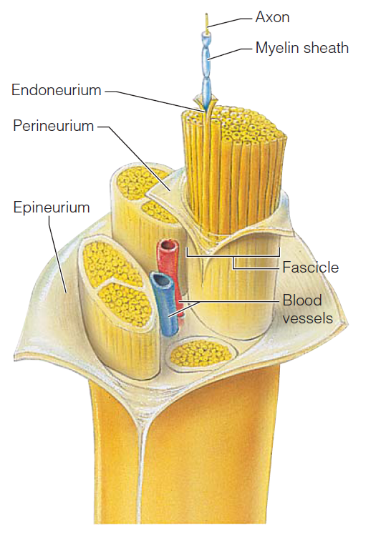
Peripheral Nervous System
Structure of a Nerve:
Endoneurium surrounds each fiber
Groups of fibers are bound into fascicles by perineurium
Fascicles are bound together by epineurium

Slide 3
Classification of Nerves
Mixed nerves – both sensory and motor fibers
Afferent (sensory) nerves – carry impulses toward the CNS
Efferent (motor) nerves – carry impulses away from the CNS

Slide 4
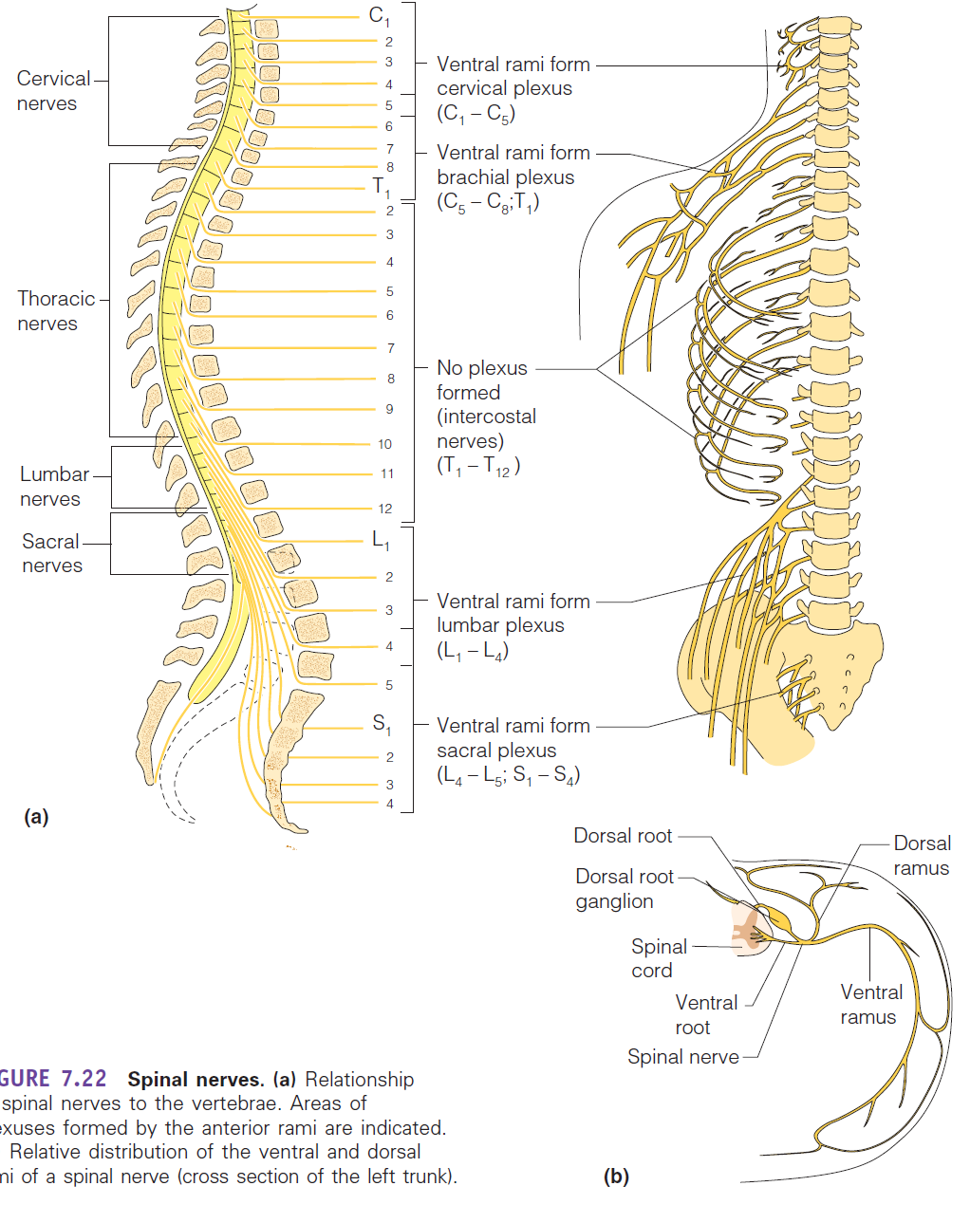
Spinal Nerves
There is a pair of spinal nerves at the level of each vertebrae

Slide 5
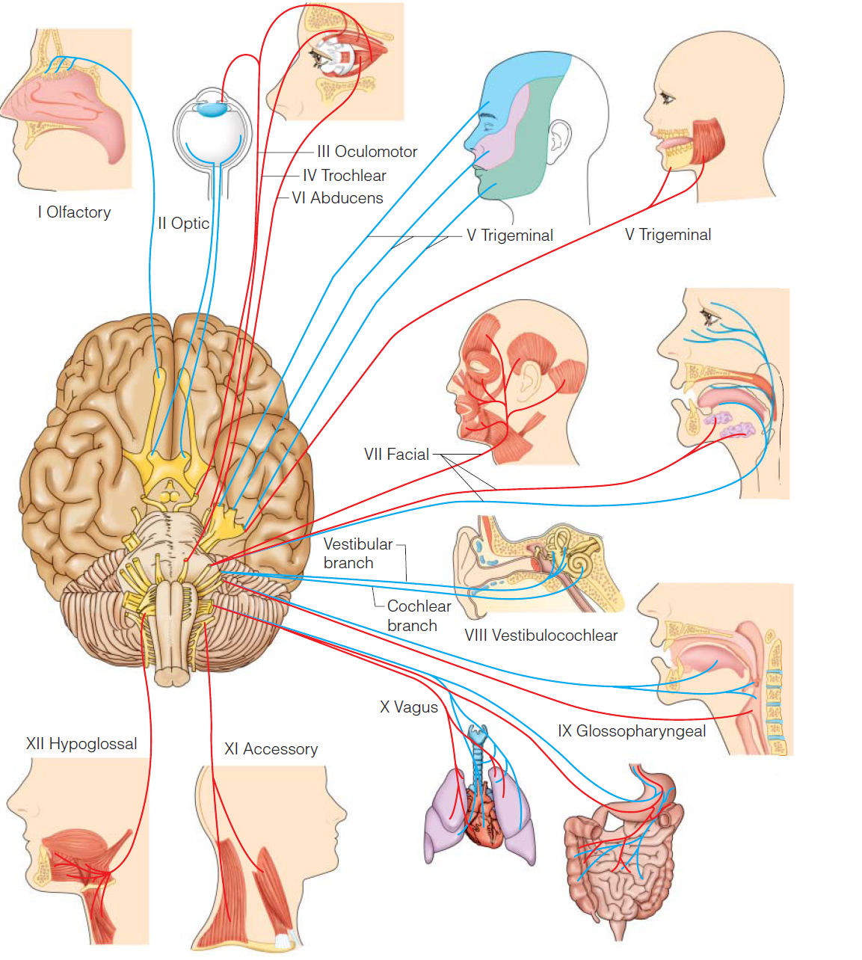
Cranial Nerves

