Slide 1
Introduction to Organizations & Management

Slide 2
Learning outcomes
Describe the characteristics of an organisation.
Explain why managers are important to organisations.
Classify managers and non-managerial employees.
Define the terms: management, efficiency and effectiveness.
Describe the functions, roles and skills of managers.
Discuss whether the manager’s job is universal.
Outline the factors that are reshaping and redefining the manager’s job.
Explain the value of studying management.

Slide 3
What is an organisation?
An organization is a deliberate arrangement of people to accomplish some specific purpose.
All organizations share three common characteristics:
Each organization has a distinct purpose
Each organization is composed of people
All organizations develop some deliberate structure

Slide 4
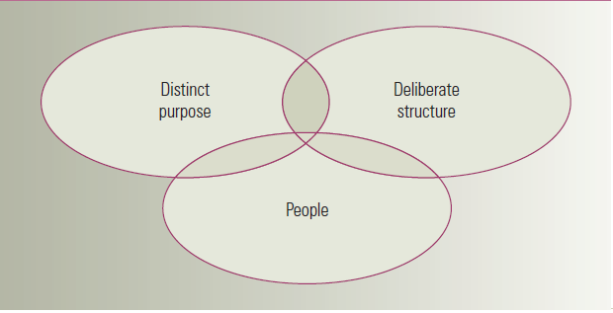
Characteristics of organizations

Slide 5
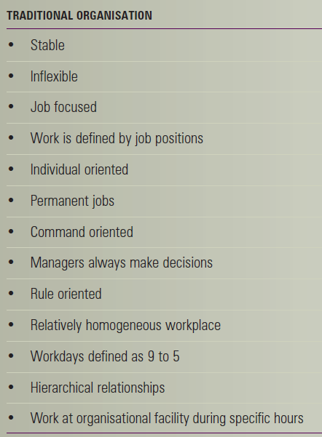
Traditional view & a contemporary view of organizations

Slide 6
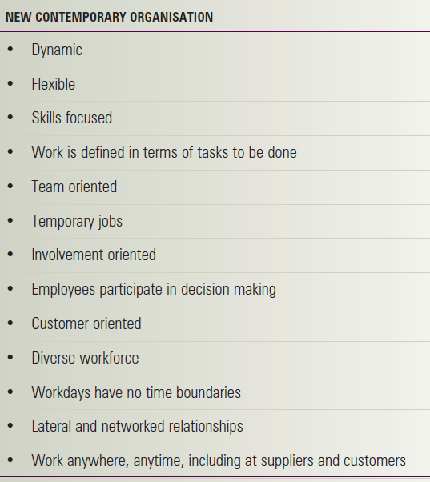
Traditional view & a contemporary view of organizations

Slide 7
Why are managers important?
The organizations need their managerial skills and abilities.
Managers are critical to getting things done.
Managers do matter to organizations!

Slide 8
Why are managers?
A manager is someone who coordinates and oversees the work of other people so that organizational goals can be accomplished.

Slide 9
Managerial levels
First-line managers: managers at the lowest level of the organization who manage the work of non-managerial employees who are directly involved with the production or creation of the organization's products.
Middle managers: managers between the first-line level and the top level of the organization who manage the work of first-line managers.
Top managers: managers at or near the top level of the organization who are responsible for making organization-wide decisions and establishing the goals and plans that affect the entire organization.

Slide 10
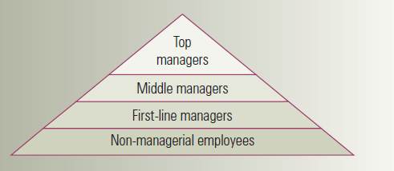
Managerial levels

Slide 11
What is Management?
Management: the process of coordinating and overseeing the work activities of others so that their activities are completed efficiently and effectively.
Efficiency: doing things right, or getting the most output from the least amount of inputs.
Effectiveness: doing the right things, or completing activities so that organizational goals are attained.

Slide 12
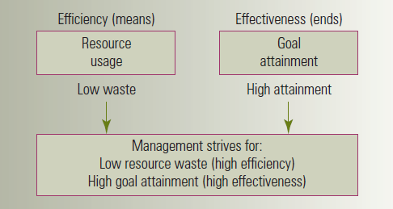
Efficiency and effectiveness in management

Slide 13
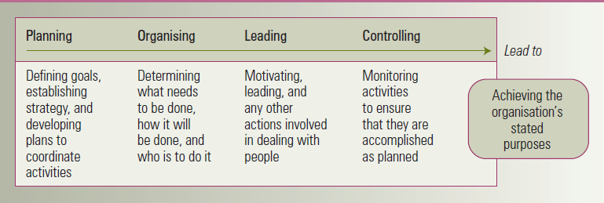
Management functions

Slide 14
Management roles
The term management roles refers to: specific categories of managerial behavior expected of and exhibited by a manager.
Henry Mintzberg, a prominent management researcher, conclude that managers perform ten different but highly interrelated roles.

Slide 15
Mintzberg’s managerial roles
Interpersonal roles (3 roles): managerial roles that involve people and other duties that are ceremonial and symbolic in nature.
Informational roles (3 roles): managerial roles that involve receiving, collecting and disseminating information.
Decisional roles (4 roles): managerial roles that revolve around making decisions.

Slide 16
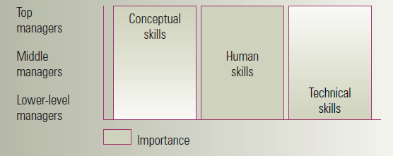
Katz’s 3 essential managerial skills
Technical skills: Knowledge of and proficiency in a certain specialized field.
Human skills: The ability to work well with other people individually and in a group.
Conceptual skills: The ability to think and to conceptualize about abstract and complex situations.

Slide 17
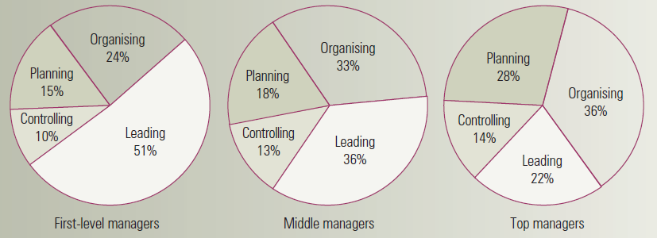
Is the manager’s job universal?
As managers move up the organization they do more planning and less direct supervising.
Distribution of time per function by organizational level:

Slide 18
Universality of management
The management is needed in all types and sizes of organizations, at all organizational levels, in all organizational areas and in organizations in all countries around the globe.

Slide 19
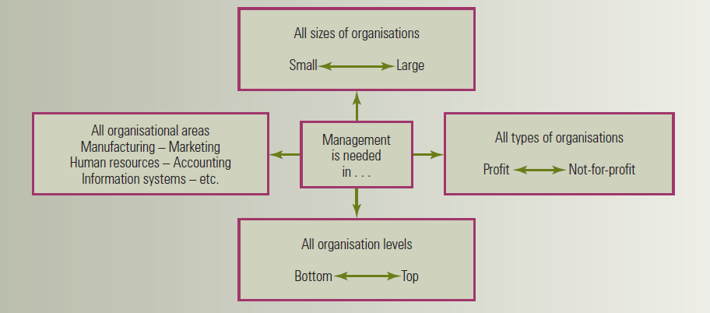
Universal need for management

Slide 20
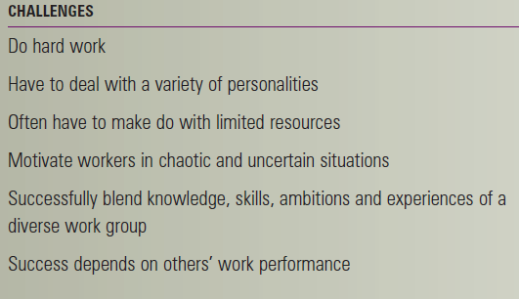
Challenges & rewards of being a manager

Slide 21
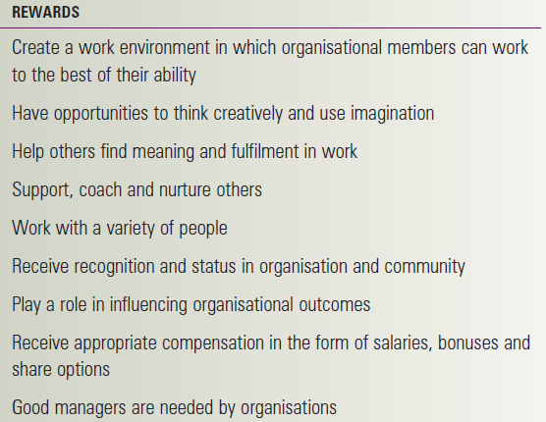
Challenges & rewards of being a manager

