Slide 1
Financial Accounting
IFRS 4th Edition
Weygandt ● Kimmel ● Kieso
Chapter 7
Fraud, Internal Control, and Cash

Slide 2
Chapter Outline
Learning Objectives
LO 1 Define fraud and the principles of internal control.
LO 2 Apply internal control principles to cash.
LO 3 Identify the control features of a bank account.
LO 4 Explain the reporting of cash.

Slide 3
Learning Objective 1 Define Fraud and the Principles of Internal Control

Slide 4
Fraud and Internal Control (1 of 2)
Fraud
Dishonest act by an employee that results in personal benefit to the employee at a cost to the employer.
Opportunity
Financial Pressure
Rationalization
ILLUSTRATION 7.1 Factors that contribute to fraudulent activity

Slide 5
Fraud and Internal Control (2 of 2)
Internal Control: is a process designed to provide reasonable assurance regarding the achievement of company objectives related to operations.
Purposes of internal control:
Safeguard assets.
Enhance accuracy and reliability of accounting records.
Increase efficiency of operations.
Ensure compliance with laws and regulations.

Slide 6
Internal Control (3 of 3)
Five Primary Components:
Control environment.
Risk assessment.
Control activities.
Information and communication.
Monitoring.

Slide 7
Learning Objective 2 Apply Internal Control Principles to Cash

Slide 8
Cash Controls (1 of 2)
Cash is the asset most susceptible to fraudulent activities Cash Receipts Controls
Establishment of Responsibility:
Only designated personnel are authorized to handle cash receipts.
Segregation of Duties: Different individuals
Receive cash
Record cash receipts
Hold cash

Slide 9
Cash Receipt Controls (1 of 5)
Documentation Procedures: Use
Remittance advice (mail receipts)
Cash register tapes or computer records
Deposit slips
Physical Controls
Store cash in safes and bank vaults
Limit access to storage areas
Use cash registers or point-of-sale terminals

Slide 10
Cash Receipt Controls (2 of 5)
Independent Internal Verification
Supervisors count cash receipts daily
Assistant treasurer compares total receipts to bank deposits daily
Human Resource Controls
Bond personnel who handle cash
Require employees to take vacations
Conduct background checks

Slide 11
Over-the-Counter Receipts
Cash Receipts Controls
Clerk Enters sales( visible to customer), counts cash |  | Supervisor Removes locked cash register tape
Sends cash and count to cashier |  | Sends cash register tape to accounting dept.
Cashier Counts cash, prepares deposit slips | Sends deposit slip copy to accounting dept. | Accounting Department Agrees register tape to deposit slip and records journal entry
Delivers cash and deposit slip to bank |  | Bank

Slide 12
Over-the counter Receipts
In some cases, the amount deposited at the bank will not agree with the cash recorded in the accounting record based on the cash register tape. Example: suppose that the cash register tape indicated sales of $6,956 but the amount of cash was only $6,946. what would the company record? Dr cash 6,946
Dr cash over and short ( 6,956-6,946) 10 Misc exp Cr sales rev 6,956

Slide 13
Over-the counter Receipts
In some cases, the amount deposited at the bank will not agree with the cash recorded in the accounting record based on the cash register tape. Example: suppose that the cash register tape indicated sales of $6,946 but the amount of cash was only $6,956. what would the company record? Dr cash 6,956
Cr cash over and short 10 Misc rev
Cr sales rev 6,946

Slide 14
Cash Receipt Controls (3 of 5)
Mail Receipts
Should be opened by two people, a list prepared, and each check endorsed “For Deposit Only”
Each mail clerk signs the list to establish responsibility for the data
Original copy of the list, along with checks, is sent to cashier’s department
Copy of list is sent to accounting department for recording, clerks keep a copy.

Slide 15
Cash Disbursement Controls
Companies disburse cash to pay expense and liabilities or purchase assets … etc. Generally, internal control over cash disbursements is more effective when companies pay by check or electronic funds transfer (EFT) rather than by cash.
One exception is payments for incidental amounts that are paid out of petty cash.

Slide 16
Cash Controls (2 of 2)
Cash Disbursements Controls
Establishment of Responsibility
Only designated personnel are authorized to sign checks (treasurer) and approve vendors
Segregation of Duties
Different individuals approve and make payments
Check-signers do not record disbursements

Slide 17
Cash Disbursement Controls (1 of 6)
Documentation Procedures
Use prenumbered checks and account for sequence
Each check must have an approved invoice
Require employees to use corporate credit cards for reimbursable expenses
Stamp invoices “paid”

Slide 18
Cash Disbursement Controls (2 of 6)
Physical Controls
Store blank checks in safes, with limited access
Print check amounts by machine in indelible ink
Independent Internal Verification
Compare checks to invoices
Reconcile bank statement monthly

Slide 19
Cash Disbursement Controls (3 of 6)
Human Resource Controls:
Bond personnel who handle cash
Require employees to take vacations
Conduct background checks

Slide 20
Cash Disbursement Controls (6 of 6)
Voucher System Controls
A network of approvals by authorized individuals, acting independently, to ensure all disbursements by check are proper.
A voucher is an authorization form prepared for each expenditure in a voucher system.

Slide 21
Petty Cash Fund
Petty Cash Fund - Used to pay small amounts.
Imprest system Involves:
establishing the fund
making payments from the fund
replenishing the fund

Slide 22
Establishing the Petty Cash Fund
Two essential steps in establishing a petty cash fund are: 1. appointing a petty cash custodian 2. determining the size of the fund
To establish the fund, the company issues a check payable to the petty cash custodian and the custodian cashes the check and places the proceeds in a locked petty cash box.
Illustration: If Zhū Ltd. decides to establish a NT$3,000 fund on March 1, the general journal entry is :

Slide 23
Making Payments From Petty Cash (1 of 2)
Management usually limits the size of expenditures
Does not permit use of fund for certain types of transactions
Payments are documented on a prenumbered receipt
Signatures of both the custodian and the individual receiving payment are required on the receipt
Supporting documents should be attached to receipt

Slide 24
Making Payments From Petty Cash (2 of 2)
Custodian keeps receipts in petty cash box until fund is replenished
Sum of receipts and money in fund should equal established total at all times
The company doesn’t make an accounting entry to record a payment when it is made from petty cash.

Slide 25
Replenishing the Petty Cash Fund (1 of 2)
When the money in the pretty cash fund reaches a minimum level or at the end of the accounting period, the custodian initiates a request for reimbursement. He prepares a schedule of the payment that have been made and send it with the receipts and supporting documents to the treasurer who approves the request. At the same time all documents are stamped (paid).
Illustration: On March 15, the custodian had requested to replenish the fund. the fund contains NT$390 cash and petty cash receipts for postage NT$1,320, freight-out NT$1,140, and miscellaneous expenses NT$150. The entry is:

Slide 26
Replenishing the Petty Cash Fund (2 of 2)
Illustration: Assume in the preceding example that the custodian had only NT$360 in cash in the fund plus the receipts as listed. The request for reimbursement would therefore be for NT$2,640 and Zhū would make the following entry.

Slide 27
DO IT! 2b: Petty Cash Fund
Bateer Company established a $50 petty cash fund on July 1. On July 30, the fund had $12 cash remaining and petty cash receipts for postage $14, office supplies $10, and delivery expense $15. Prepare journal entries on July 1 and on July 30.
July 1
Petty Cash
50
Cash
50
July 30
Postage Expense
14
Supplies
10
Delivery Expense
15
Cash Over and Short
1
Cash
38

Slide 28
Petty Cash Fund

Slide 29
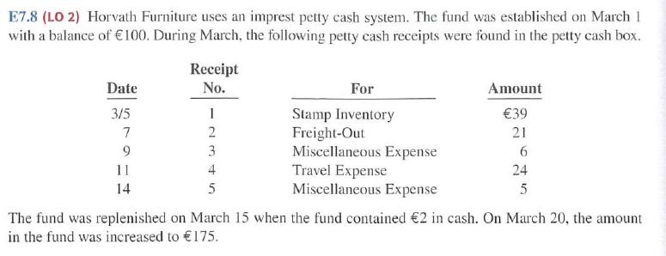
Petty Cash Fund

Slide 30
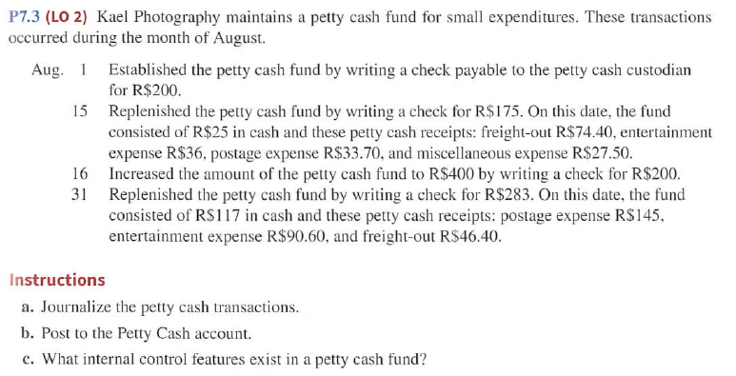
Petty Cash Fund

Slide 31
Learning Objective 3 Identify the Control Features of a Bank Account

Slide 32
Control Features of a Bank Account
Use of a bank contributes significantly to good internal control over cash.
Minimizes amount of currency on hand
Creates a double record of bank transactions
Bank reconciliation تسوية البنكis the process of comparing the bank’s balance with the company’s balance and explaining the differences to make them agree

Slide 33
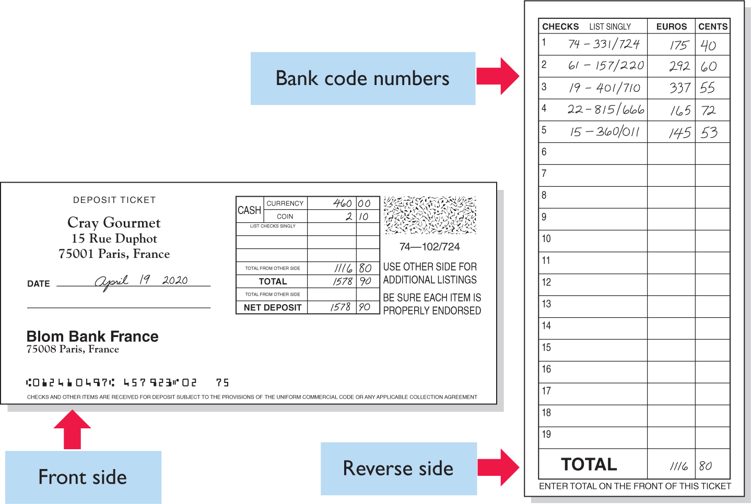
Making Bank Deposits
Authorized employee should make deposit which must be documented by a deposit slip.

Slide 34
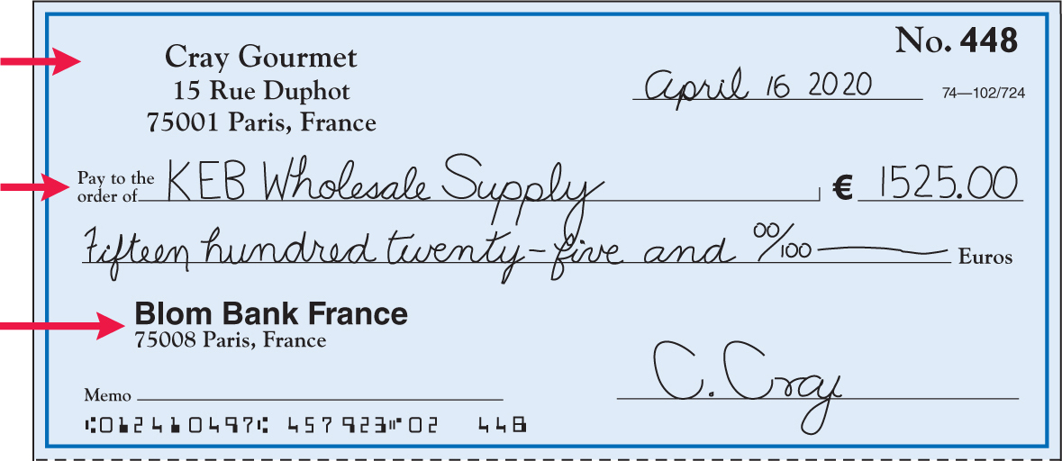
Writing Checks
Written order signed by depositor directing bank to pay a specified sum of money to a designated recipient. It is a negotiable instrument.
Maker
Payee
Payer
ILLUSTRATION 8.9
Check with remittance advice

Slide 35
Bank Statements (1 of 6)
Prepared from bank’s perspective
Every deposit bank receives is an increase in bank’s liabilities (an account payable to the depositor)
Lists in numerical sequence all paid checks along with date check was paid and its amount and stamp the check as paid ( canceled )
Bank includes with bank statement memoranda explaining other debits and credits it made to depositor’s account
A check that is not paid by a bank because of insufficient funds in a bank account is called an NSF check (not sufficient funds)

Slide 36
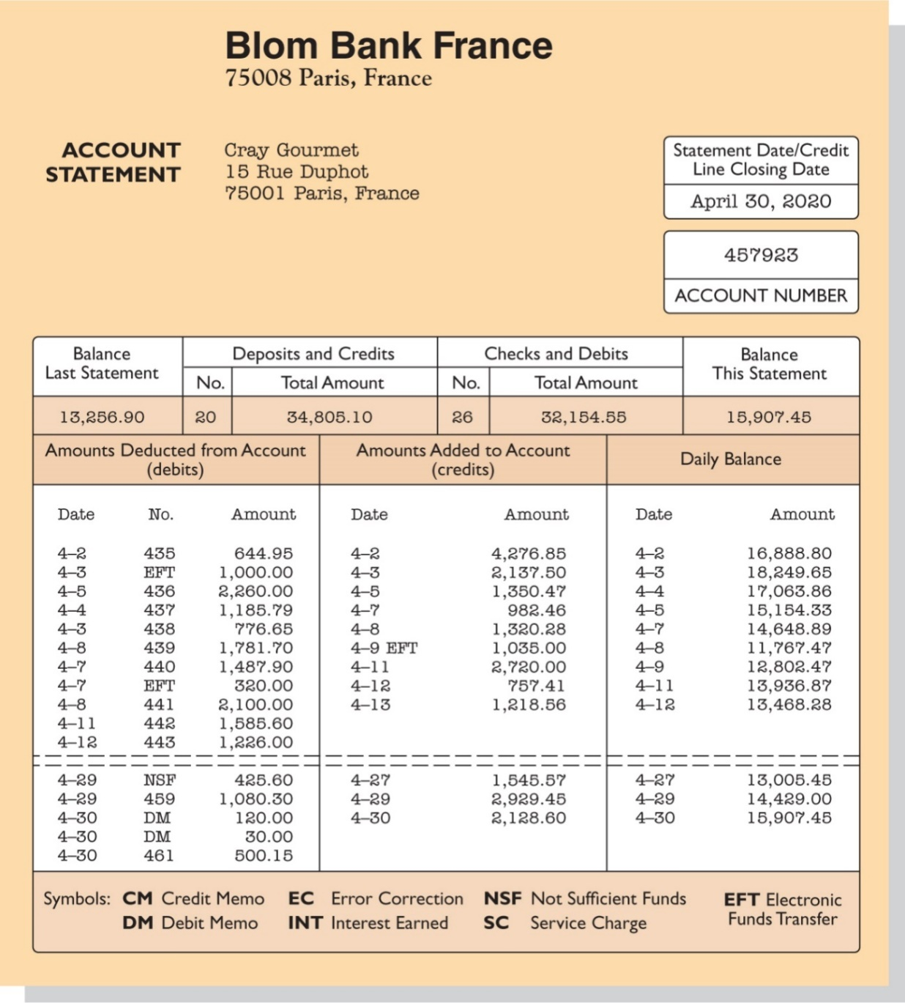
Bank Statements (2 of 6)
Each month, the company receives from the bank a bank statement showing its bank transactions and balances.

Slide 37
Reconciling the Bank Account
Reconcile balance per books and balance per bank to their “correct or true” balance.
The need for reconciliation:
Time Lags
Deposits in transit ايداعات بالطريق ( مسجلة بدفاتر الشركة و مش مسجلة عند البنك )
Outstanding checks شيكات مسجلة في دفاتر الشركة و مش مسجلة عند البنك
Bank memoranda بنود مسجلة عند البنك ومش مسجلة عند الشركة DM ( (عمولات مسجلة عند البنك و مش مسجلة عند الشركةCM ( بنود تزيد من حساب الشركة في البنك مسجلة عند البنك و مش مسجلة عند الشركة)
Errors
Info : Bank reconciliation should be done by an employee who has no other responsibilities related to cash

Slide 38
Reconciling the Bank Account
Reconciliation Procedure
Cash Balance Per Bank |  |  | Cash Balance Per Books
+ | Deposits in transit |  | + | Electronic fund transfer &Collection of note rec and interest earned
- | Outstanding checks
+/- | Bank errors |  | - | NSF (bounced) checks
 |  |  | - | Service charges and other Payments
 |  |  | +/- | Company errors
Corrected Balance |  |  | Corrected Balance

Slide 39
Bank Reconciliation Illustrated (1 of 4)
The bank statement for Cray Gourmet, which the company accessed online, shows a balance per bank of €15,907.45 on April 30, 2020. On this date the balance of cash per books is €11,709.45. From the foregoing steps, Cray determines the following reconciling items for the bank.
Step 1. Deposits in transit (+): DIT March 31.2020 was € 1,101.4, deposit per bank during April is € 2,900, cash receipts per the company’s books during Apr is €4,000 €2,201.40
Step 2. Outstanding checks (−): No. 453, €3,000.00;
No. 457, €1,401.30; No. 460, €1,502.70. 5,904.00
Step 3. Bank errors (+/−): None.
Reconciling items per books are as follows:

Slide 40
Reconciling items per books are as follows:
Step 1. CM: Other deposits (+): Unrecorded electronic
receipt from customer on account on April 9
determined from the bank statement. €500.00
Collection of 500 note plus interest earned 50 minus fees 15 535.00
Step 2. DM: Other payments (−): Unrecorded charges
determined from the bank statement are as follows:
Returned NSF check on April 29 425.60
Debit and credit card fees on April 30 120.00
Bank service charges on April 30 30.00
Step 3. Company errors (+): Check No. 443 was correctly
written by Cray for €1,226 and was correctly paid by the
bank on April 12. However, it was recorded as €1,262 on
Cray’s books. 36.00

Slide 41
Bank Reconciliation April 30, 2020
Cash balance per bank statement |  |  |  | €15,907.45
Add: | Deposits in transit |  |  | 2,201.40
Less: | Outstanding checks
 | No. 453 | €3,000.00
 | No. 457 | 1,401.30
 | No. 460 | 1,502.70 |  | 5,904.00
Adjusted cash balance per bank |  |  |  | €12,204.85
Cash balance per books |  |  |  | €11,709.45
Add: | Electronic funds transfer received | €1,035.00
 | Error in recording check No. 443 | 36.00 |  | 1,071.00
Less: | NSF check | 425.60
 | Debit and credit card fees | 120.00
 | Bank service charge | 30.00 |  | 575.60
Adjusted cash balance per books |  |  |  | €12,204.85

Slide 42
Bank Reconciliation Illustrated (2 of 4)
Entries From Bank Reconciliation done by the depositor
Collection of Electronic Funds Transfer: Payment of account by customer. The entry is:
Apr. 30
Cash
500.00
Accounts Receivable
500.00
Apr. 30
Cash
535.00
Note receivable interest revenue
500.00
35.00

Slide 43
Bank Reconciliation Illustrated (3 of 4)
Book Error: The cash disbursements journal shows that check no. 443 was a payment on account to Roux Foods, a supplier. The correcting entry is:
Apr. 30
Cash
36.00
Accounts payable
36.00
N S F Check: As indicated earlier, an NSF check becomes an account receivable to the depositor. The entry is:
Apr. 30
Accounts receivable
425.60
Cash
425.60

Slide 44
Bank Reconciliation Illustrated (4 of 4)
Bank Charges Expense: Fees for processing debit and credit card transactions (€120) and the bank service charges (€30) have been combined in a single entry as follows:
Apr. 30
Bank Charge Expense
150.00
Cash
150.00
Cash
Apr. 30 | Balance | 11,709.45 | Apr. 30 | 425.60
30 |  | 500.00 535.00 | 30 | 150.00
30 |  | 36.00
Apr. 30 | Balance | 12,204.85

Slide 45
Do It! 3: Bank Reconciliation
Deepika Kann owns Deepika Fine Fabrics. Deepika asks you to explain how she should treat the following reconciling items when reconciling the company’s bank account: (1) a debit memorandum for an NSF check, (2) a credit memorandum for an electronic funds transfer from one of the company’s customers received by the bank, (3) outstanding checks, and (4) a deposit in transit.
Solution
Sally should treat the reconciling items as follows.
N S F check:
Deduct from balance per books
Electronic funds transfer:
Add to balance per books
Outstanding checks:
Deduct from balance per bank
Deposit in transit:
Add to balance per bank

Slide 46
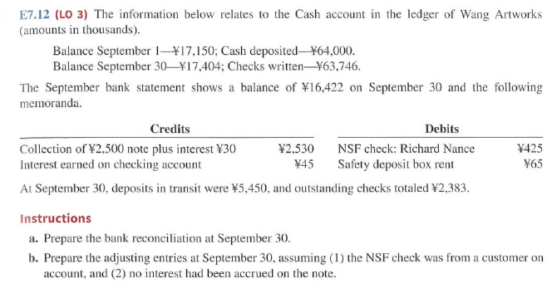
Bank Reconciliation

Slide 47
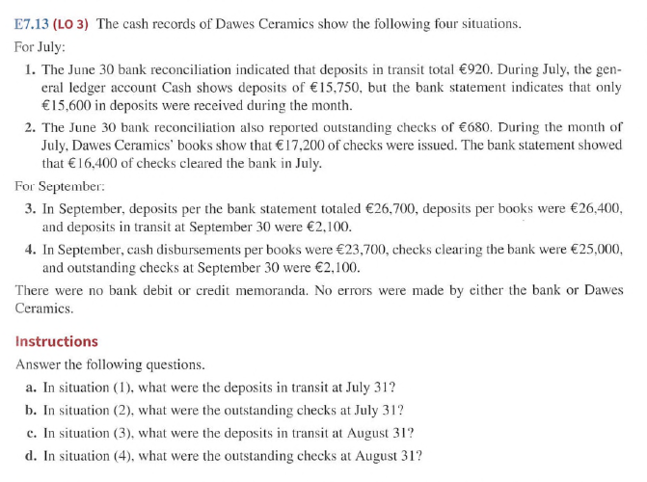
Bank Reconciliation

Slide 48
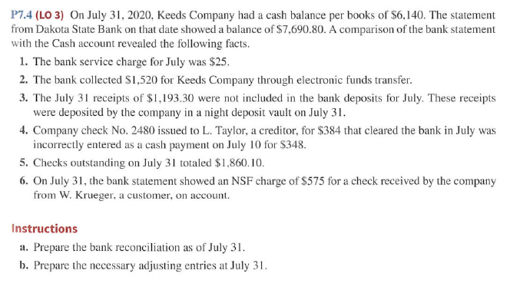
Bank Reconciliation

Slide 49
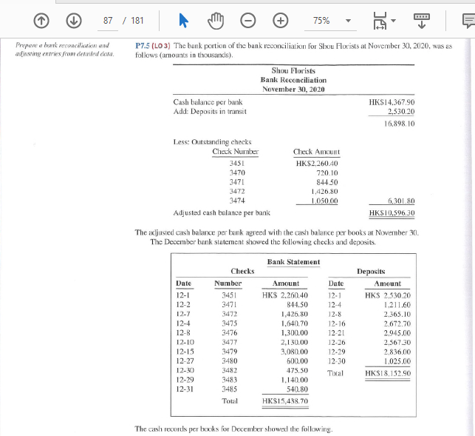
Bank Reconciliation

Slide 50
Learning Objective 4 Explain the Reporting of Cash

Slide 51
Reporting of Cash
Cash consists of coins, currency (paper money), checks, money orders, and money on hand or deposit
The statement of financial position reports amount of cash available at a given point in time
Listed first in current assets section
Statement of cash flows shows sources and uses of cash during a period of time

Slide 52
Reporting Cash (1 of 4)
Cash Equivalents
Cash equivalents are short-term, highly liquid investments that are both:
Readily convertible to known amounts of cash, and
So near their maturity that their market value is relatively insensitive to changes in interest rates.
Restricted Cash
Cash that is not available for general use. It should be reported separately.

Slide 53
Reporting Cash
Korean Air Lines, Inc. Statement of Financial Position (partial, in millions)
Assets
Current assets
Short-term investments | ₩111,988
Restricted cash Cash and cash equivalents | 967,481

Slide 54
Reporting Cash (3 of 4)
Review Question
Which of the following statements correctly describes the reporting of cash?
a. Cash cannot be combined with cash equivalents.
b. Restricted cash funds may be combined with Cash.
c. Cash is listed first in the current assets section.
d. Restricted cash funds cannot be reported as a current asset.

Slide 55
Reporting Cash (4 of 4)
Review Question
Which of the following statements correctly describes the reporting of cash?
a. Cash cannot be combined with cash equivalents.
b. Restricted cash funds may be combined with Cash.
c. Cash is listed first in the current assets section.
d. Restricted cash funds cannot be reported as a current asset.

Slide 56
DO IT! 4: Reporting Cash
Indicate whether each of the following statements is true or false.
Cash and cash equivalents are comprised of coins, currency (paper money), money orders, and NSF checks.
Restricted cash is classified as either a current asset or non-current asset, depending on the circumstances.
A company may have a negative balance in its bank account. In this case, it should off set this negative balance against cash and cash equivalents on the statement of financial position.
Because cash and cash equivalents often includes short-term investments, accounts receivable should be reported as the last item on the statement of financial position.
1. False 2. True 3. False 4. False

