Slide 1
Contex-Free Languages

Slide 2
Introduction
Regular languages describes simple patterns
Not all languages are regular
Some important patterns cannot be described by regular languages
For example, there is a nested pattern of left and right parenthesis used in programming languages, e.i., ((()))
The number of left parenthesis equals the number of right parenthesis
This can be expressed using L = {a^{n}b^{n}: n>=0}
L is not regular
So, we need to enlarge the family of languages and consider Context-free languages.

Slide 3
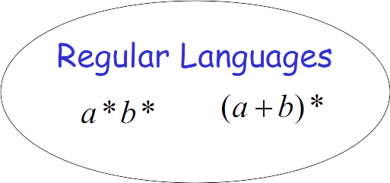
Context-Free Grammars

Slide 4
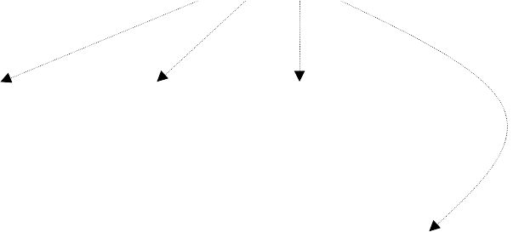
Definition: Context-Free Grammars
Variables
Terminal
symbols
Start
variable
Productions of the form:

Slide 5
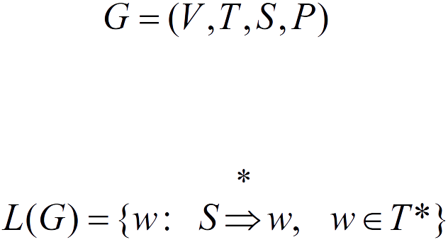

Slide 6
Definition: Context-Free Languages
A language is context-free
if and only if
there is a context-free grammar
with

Slide 7
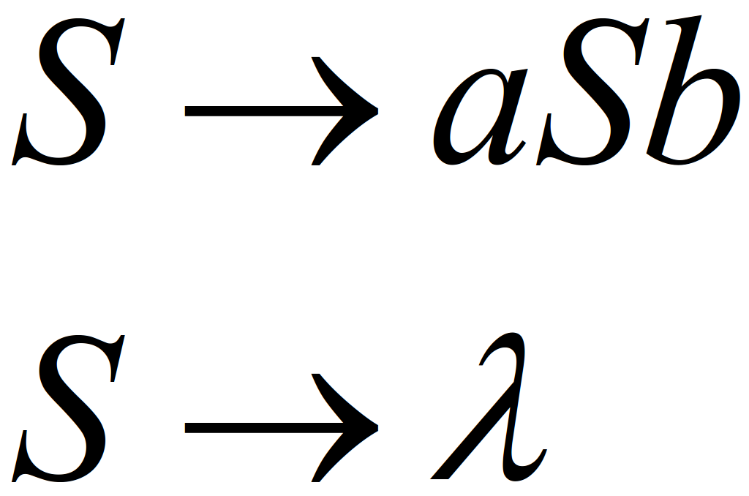
Example
A context-free grammar :
A derivation:
Another derivation:

Slide 8
Example: continue
Describes parentheses: (((( ))))

Slide 9
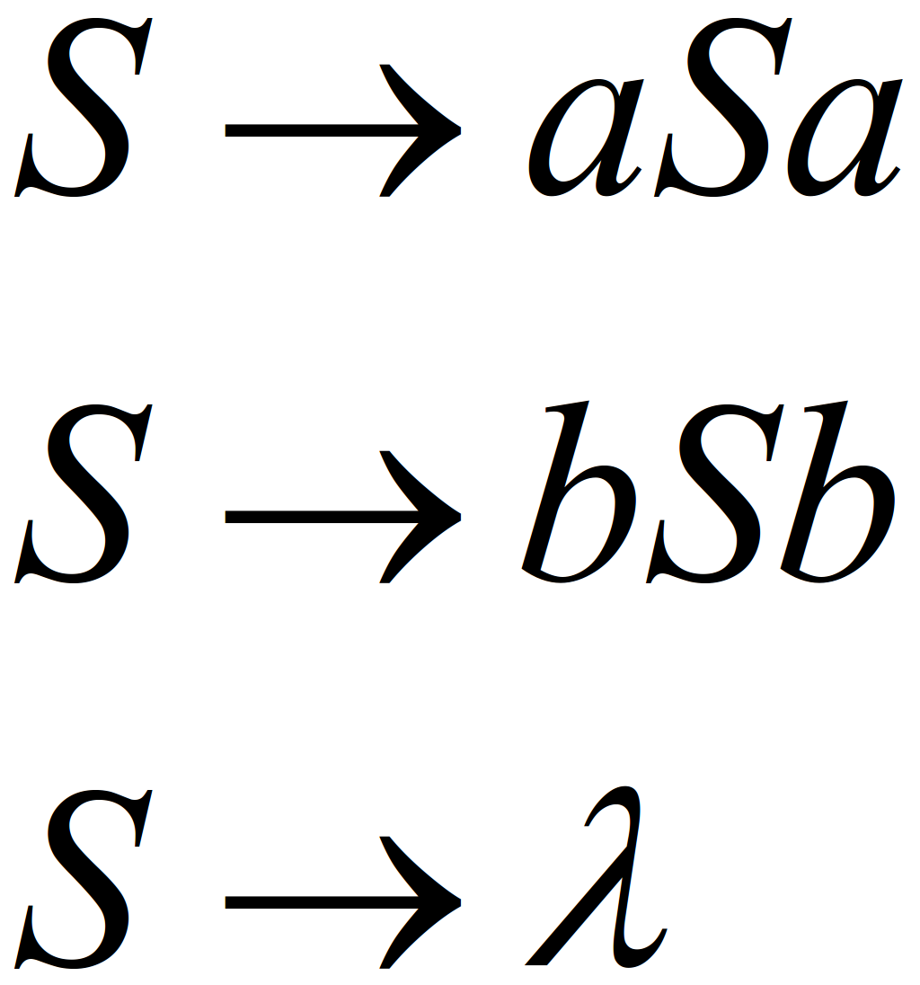
Example:
A context-free grammar :
A derivation:

Slide 10
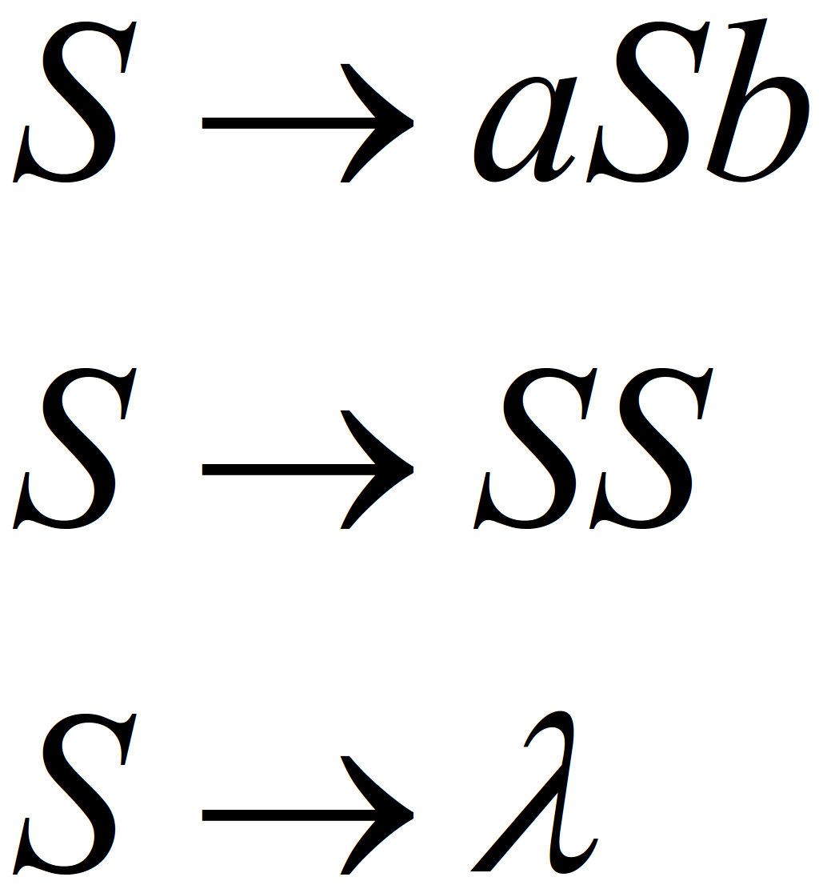
Example
A context-free grammar :
Derivations:

Slide 11
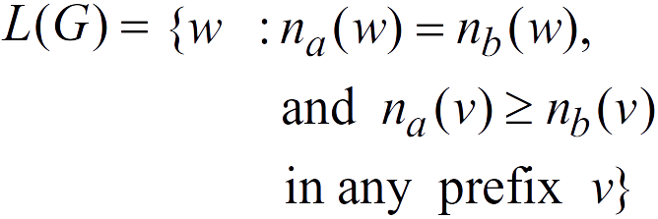
Example: continue
Describes matched parentheses: () ((( ))) (( ))

Slide 12
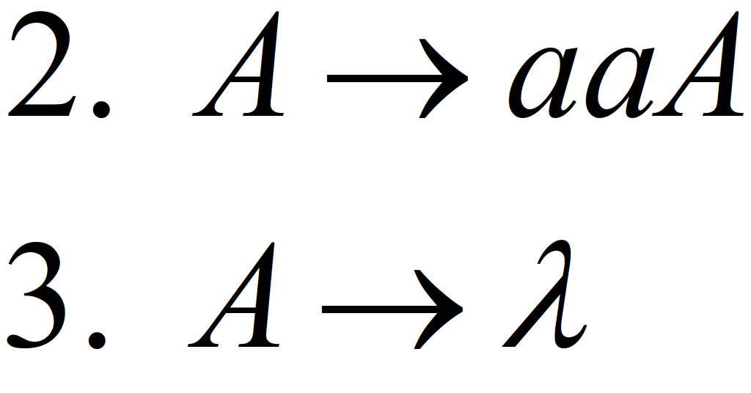
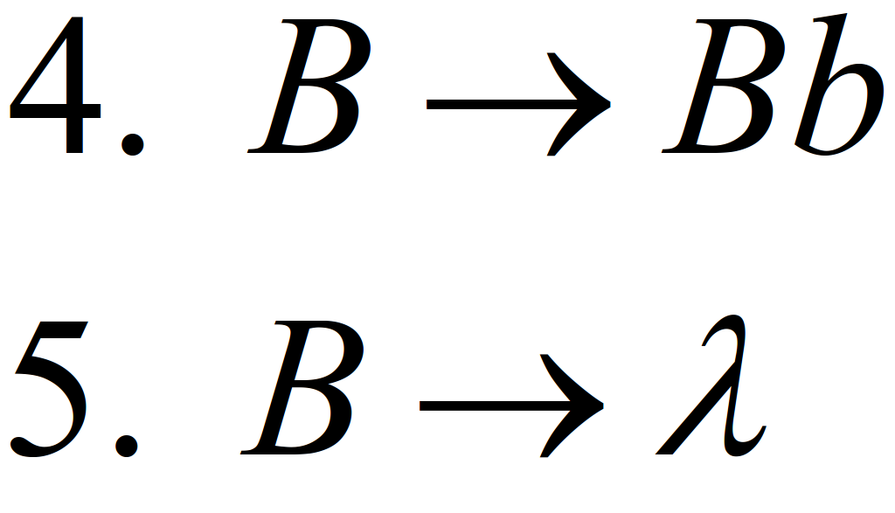
Derivation Order
Leftmost derivation:
Rightmost derivation:

Slide 13
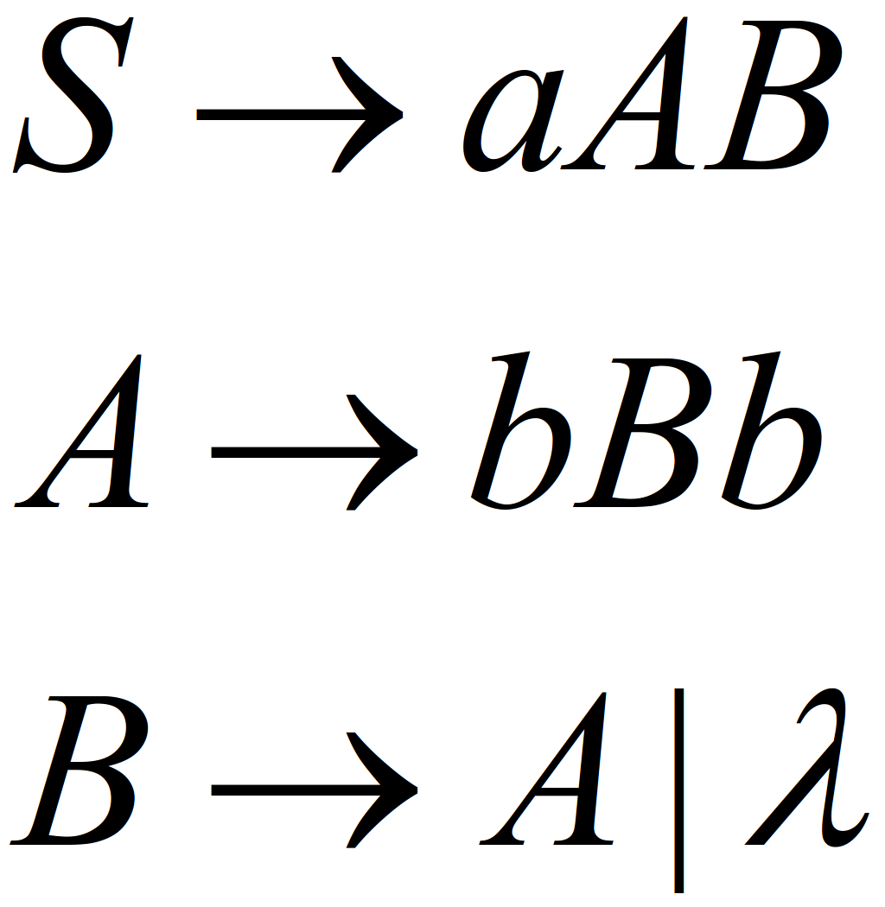
Example
Leftmost derivation:
Rightmost derivation:

Slide 14
Derivation Trees
A way for showing derivations independent of the order in which productions are used, also referred to as derived trees.
Example: a part of a derivation tree representing the production.

Slide 15
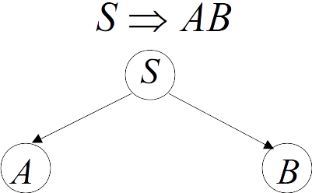
Example

Slide 16
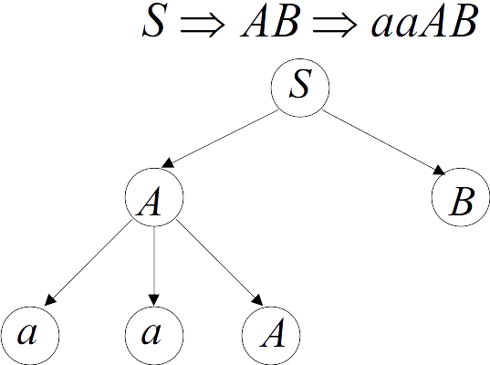
Example: continue

Slide 17
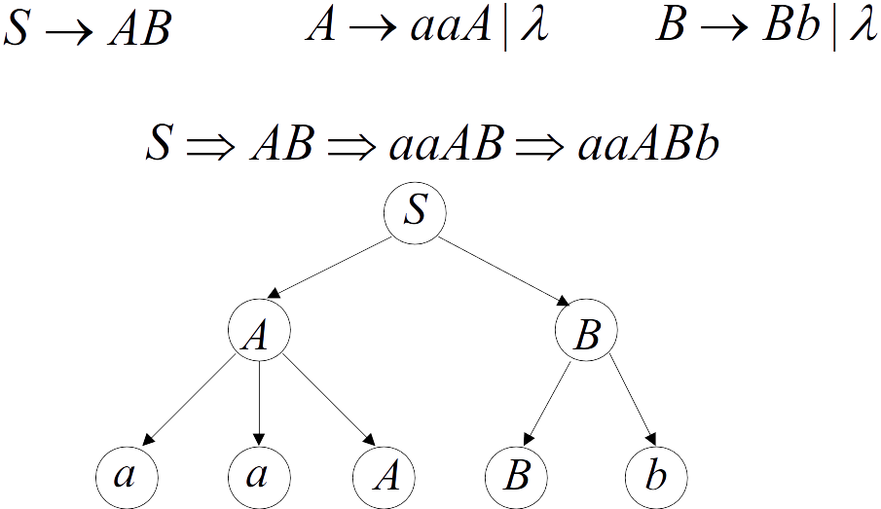
Example: continue

Slide 18
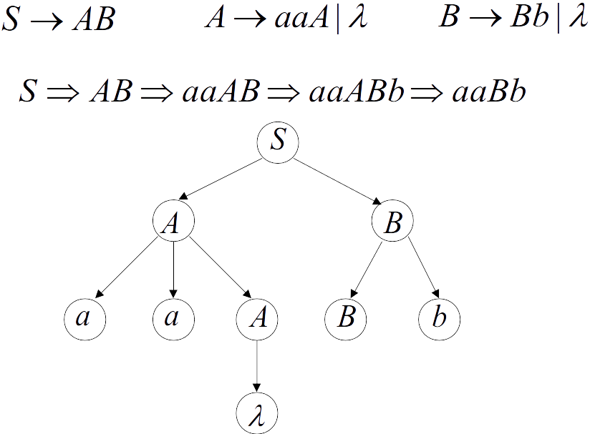
Example: continue

Slide 19
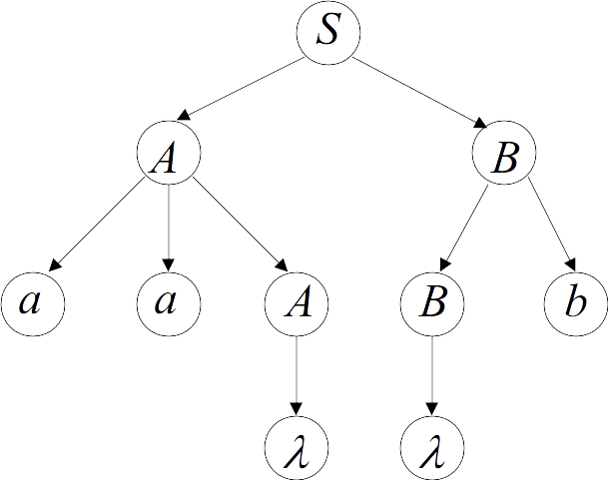
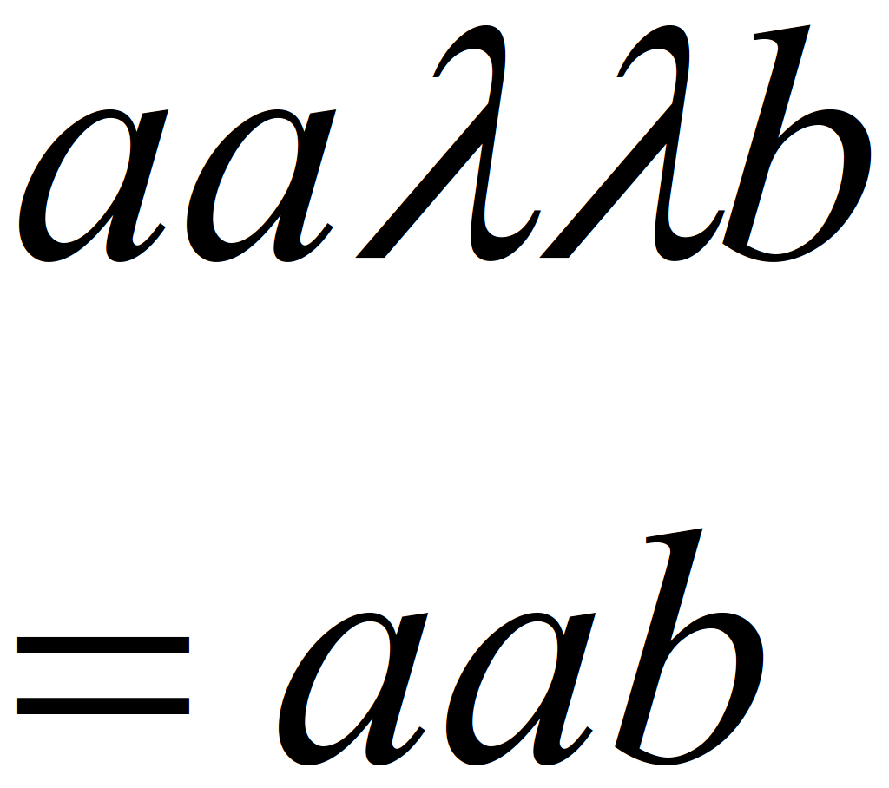
Example: continue
yield

Slide 20
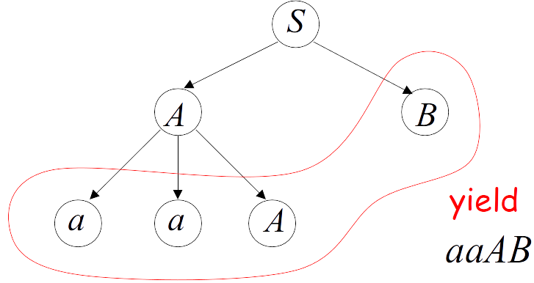
Partial Derivation Trees
Sentential form

Slide 21
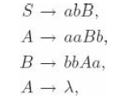
Exercises
Give a derivation tree for
Find a context-free grammar for for the language

