Slide 1
2. Introduction to Solar Energy

Slide 2
Electricity production in Palestine
Palestine electricity sources

Slide 3
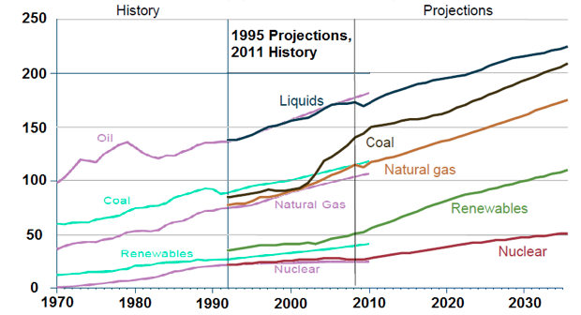
World energy consumption (quadrillion BTU)
Source: http://commons.wikimedia.org/wiki/File:World_energy_consumption_projection_1995-2011.png

Slide 4
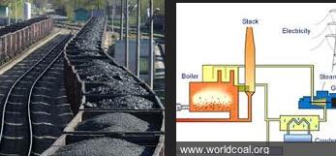
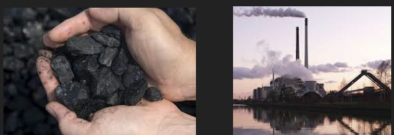
Coal Impacts
Coal’s combustion adds more carbon dioxide emissions to the atmosphere than any other resource (38% of CO₂ in the world)
Coal plants also emit toxins such as sulfur dioxide (SO₂), nitrogen oxide (NO₂), carbon monoxide (CO), hydrocarbons (HC), etc.
Coal causes health & environmental problem

Slide 5
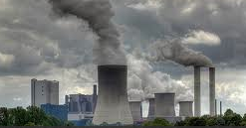
Coal energy source
Pros
Cheap: ~ 4 cents for every kWh of energy
Efficient: when burned, 40% of energy is converted into electricity
Cons
It pollutes
Releases lots of CO₂
Contributes to global warming
Mining is dangerous
strip mining destroys the environment
Non-renewable
Therefore, an alternative form of energy is called for..

Slide 6
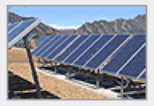
Making the change to renewable energy
Solar
Geothermal
Wind
Hydropower
Wave
Hydrogen
biomass

Slide 7
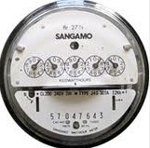
Today’s solar picture
Germany leads solar production (> 4.5 times more than US production)
Japan is the second (3 times the Americans)
Financial incentives
Investment subsidies: cost of installation of a system is subsidized
Net metering: electricity utility purchases PV electricity from producer under a multi-year contract at a guaranteed rate
Renewable Energy Certificates (RECs)

Slide 8
Primary energy resources
The electricity sector policies depend on 3 main issues:
Diversifying electric energy resources
Improving energy efficiency and maximizing energy conservation measures
Enhancing the role of renewable energy (RE) in the electric energy mix
Therefore, a Palestinian RE Strategy was formulated in 2010 to help shaping national energy plan herein.

Slide 9
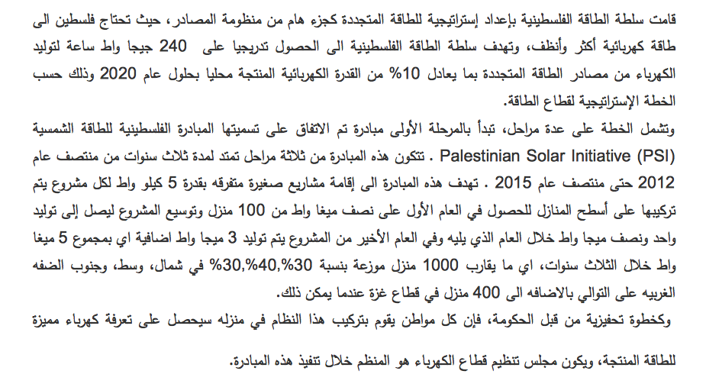
Palestinian Solar Initiative (PSI)
Source: http://www.sunergy.ps/data/uploads/6674d802b697e0c1c9297ecd7c3889f1.pdf

Slide 10
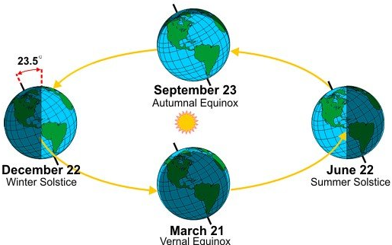
Can solar energy serve?
Yes. But, it is a little more expensive than other sources, at a rate of 30 cents/kWh
No price fluctuations for energy source
Coal and wind systems can provide power all day (and night) long, solar energy is only effective during a few hours of the day
Source: http://www.businessinsider.com/standing-an-egg-on-its-head-has-nothing-to-do-with-the-spring-equinox-2013-3

Slide 11
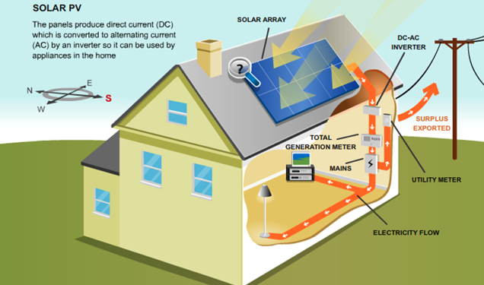
Major uses of solar energy
Generating electrical energy
Drying agricultural products
Space heating
Heating water
http://121solar.co.uk/howdoesitwork.asp

Slide 12
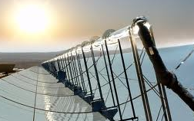
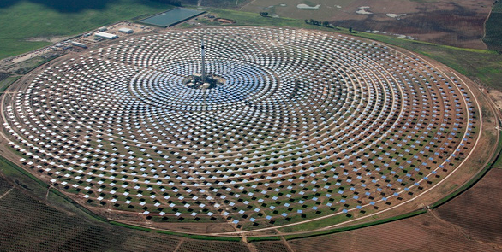
Solar technologies
Day lighting
Passive solar heating
Active solar heating
Concentrated solar thermal
photovoltaic
http://gizmodo.com/5848411/the-worlds-first-solar-plant-to-generate-electricity-even-at-night

Slide 13
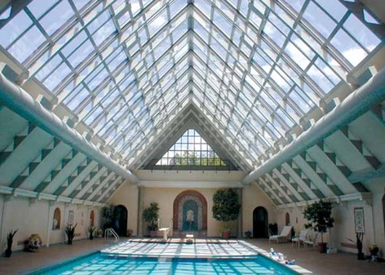
Day lighting

Slide 14
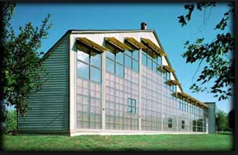
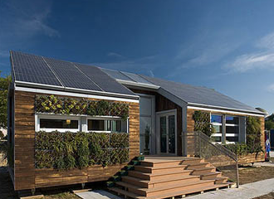
Passive solar heating
http://www.energy-enviro.com/index.php?PAGE=2287&PRINT=yes

Slide 15
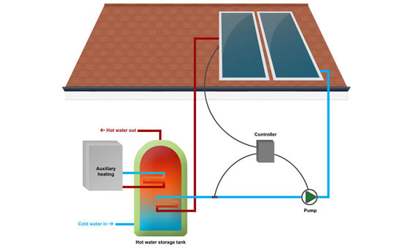
Active solar heating
http://cleangreenenergyzone.com/learn-more-about-active-solar-heating/

Slide 16
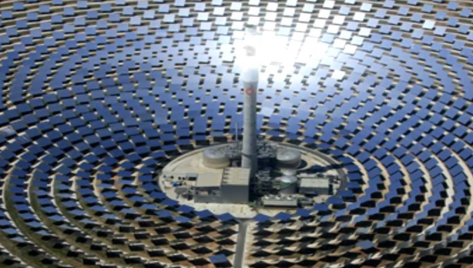
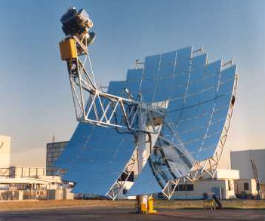
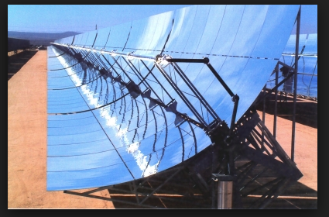
Concentrated solar thermal
http://news.cnet.com/8301-11128_3-9951463-54.html

Slide 17
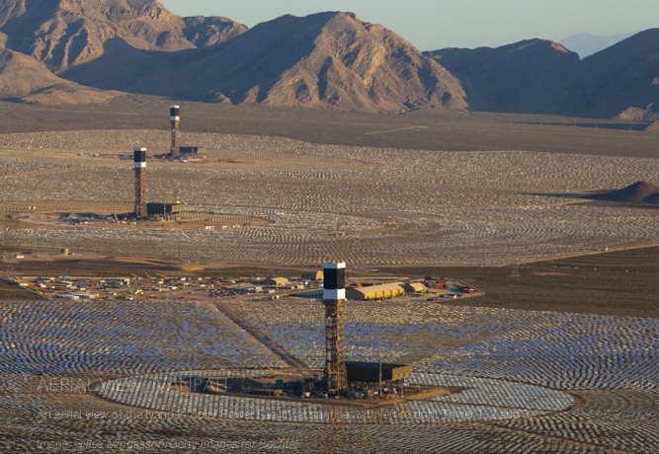
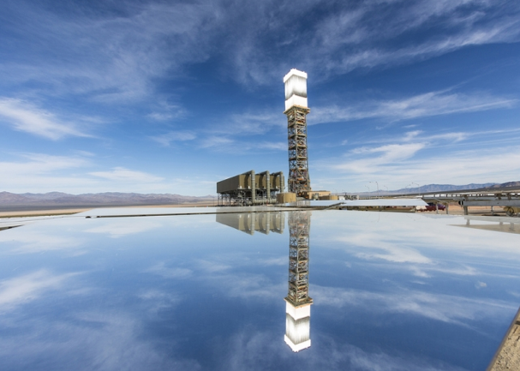
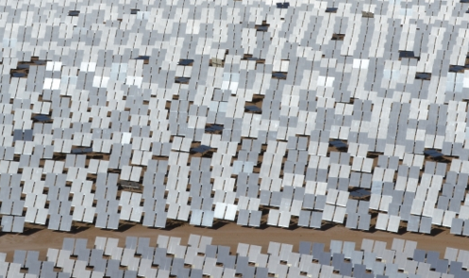
World's Largest Concentrating Solar Power Plant
Where: Ivanpah, California
Cost: $1.6 billion
Capacity: 392 Mega Watt
Homes served: 94,400
http://www.energy.gov/articles/celebrating-completion-worlds-largest-concentrating-solar-power-plant

Slide 18
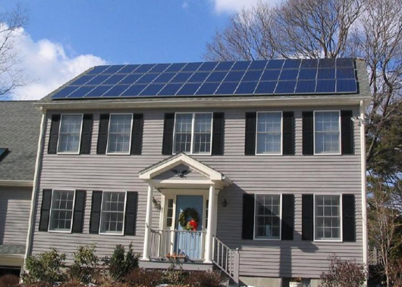
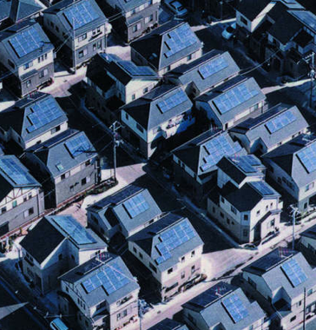
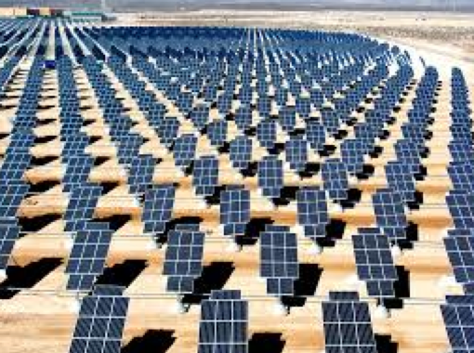
Photovoltaic
West Roxbury, Boston
http://www.boston.com/yourtown/news/west_roxbury/2013/04/west_roxbury_gets_a_push_to_go.html

Slide 19
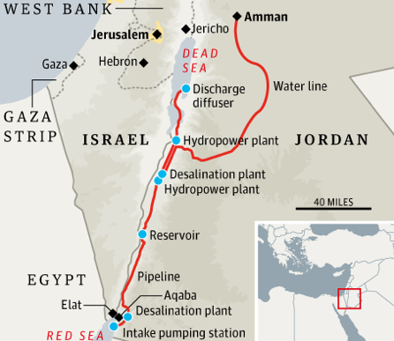
Term projects
http://www.inhabitat.com/wp-content/uploads/bahrain1.jpg
Wind energy in skyscraper
Corn oil biofuel (ethanol)
Soya bean diesel
Olive mills (Jefit)
Wind farm in Palestine
Nanotechnology in RE
RE applications in Palestine
The Red Dead Canal
Palestinian law and RE
Environmental impacts of RE
Hybrid vehicles
Energy transport and storage
Energy conversion

