Slide 1
The basics of a healthy diet
Alma Irshaid

Slide 2
CHAPTER OBJECTIVES
Understand the basics of a healthy eating plan; variety, balance, moderation, nutrient density and energy density
Identify the components of nutrition assessment process; analyzing Background and evaluating the ABCDEs
Define each component of the assessment; anthropometric, biochemical, clinical, dietary, and economic.
learn the methods of dietary assessment

Slide 3
Introduction
Healthy diet accompanied by a healthy lifestyle guarantee:
well-being
Minimizing the risk of developing common nutrition related diseases
This means a consumption of a varied foods balanced by a moderate intake of each food.

Slide 4
Most importantly…
Health professionals have recommended the same basic diet and health plan for the past 40 years:
Control the quantity of food you consume
Consume food from the major food groups
Be active!

Slide 5
◆ Diet-planning principles:
Adequacy
Balance
Calorie (energy) control
Nutrient Density
Moderation
Variety

Slide 6
Adequacy
Providing all the essential nutrients, fiber, and energy in amounts sufficient to maintain health.

Slide 7
Balance
Avoid over consumption of any food
Choose a variety of items of each from the main six groups daily

Slide 8
Variety
Variety Means Eating Many Different Foods
Choosing a number of different foods within any given food group
Avoid eating the same food

Slide 9
No one food meets all the nutrient needs.
Nutrients are distributed among many food options
Example:
Meat: provides protein and iron but little calcium and no vitamin C.
Eggs: provides protein but little calcium
Cow's milk ?

Slide 10
Importance of variety:
Meals become more interesting
Ensure that a diet contains sufficient nutrients.
Example 2:
Daily consumption of carrots as a vegetable source?
* Consumption of a varied vegetables and fruits for a rich supply of phytochemicals
Notes:
anthocyanin

Slide 11
Moderation
Mostly referred to portion size
Eating moderately from all groups avoiding overconsumption
Example:
You can eat something high in fat, sugar or energy and eat a healthier option on the coming meal
Cheese burger on lunch then a fruit salad on dinner
You prefer high-fat milk, use a low-fat salad dressing

Slide 12
Don’t eliminate food
There are no “Good” or “Bad” food
High Consumption of fatty or sugary food (Fatty meats, fried food, refined starches…) can increase the risk of nutrition-related chronic diseases

Slide 13
Nutrient density
The nutrients a food provides relative to the energy it provides. The more nutrients and the fewer kcalories, the higher the nutrient density.
Used as a nutritional assessment for the quality of food
Vitamin and mineral content of food with the energy it provides is a measure of nutrient density
To calculate the nutrient density, divide milligrams by kcalories:
1 cup of milk | ½ cup of cooked beans
300 mg calcium | 100 mg calcium
85 kcal | 15 kcal

Slide 14
Empty-calorie: a term for food high in sugar and/or fat and have low content of nutrients
Certain cases need nutrient dense more than others
Older people
People on weight –loss diet plans

Slide 15
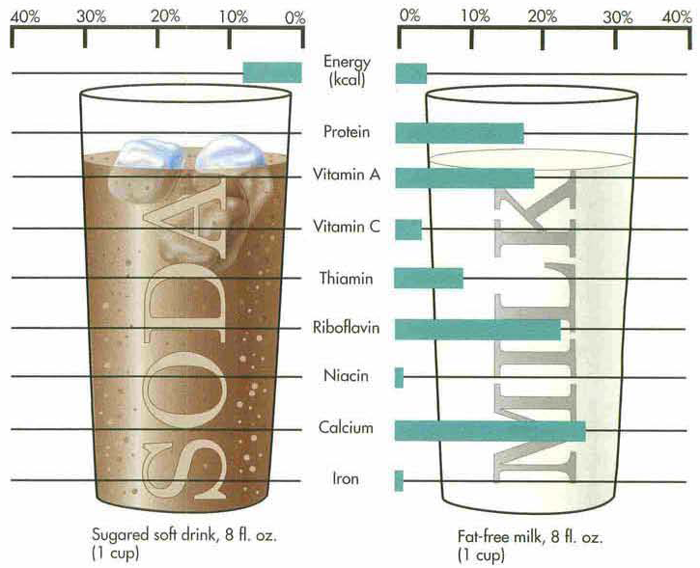

Slide 16
Energy density
A comparison of the energy content of a food with the weight of the food.
An energy-dense food is high in energy content but weighs very little (e.g., many fried foods),
Low energy-density food, such as an orange, weighs a lot but is low in energy content.

Slide 17
Examples:
Very low energy-dense food (less than 0.6 kcal/g):
Lettuce, tomatoes, strawberries, broccoli, fat-free milk, vegetable soups
Low energy- density (0.6 to 1.5 kcal/g)
- Whole-fat milk, beans, bananas, oatmeal

Slide 18
Medium energy- density (1.5 to 4 kcal/g).
Eggs, pumpkin, whole-wheat bread, raisins, cream cheese, white bread
High energy-dense food (greater than 4 kcal/g).
Chocolate, potato chips, mayonnaise, vegetable oil
low-energy dense food: have great amounts of water and fiber, increase fullness
High energy-dense food: eaten in large amounts to contribute to fullness

Slide 19
Nutrition Screening & Nutrition Assessment

Slide 20
Better Practice…
Screening
At risk
Assessment

Slide 21
Nutrition Screening
A process to identify an individual who is:
At risk of malnutrition (risk factors are present that impair intake and/or increase the body’s needs for nutrients and/or energy)
Malnourished
Likely to benefit from further nutrition assessment and treatment
It is a rapid and simple process conducted by admitting or front line staff, typically a nurse not a nutrition professional.
A.S.P.E.N. 2010
Notes:
21

Slide 22
Nutrition screening identifies those may be on the continuum between malnutrition risk (risk factors are present that can lead to malnutrition) and overt malnutrition…nutrition risk or risk of malnutrition is the presence of risk factors that sufficiently impair food intake and that will change anthropometry, body weight, body function etc. (i.e., subclinical malnutrition) if they are not addressed. Overt malnutrition is identified when there is physical signs or other evidence of the functional deficit resulting from inadequate intake to meet the body’s needs.
At risk: Susceptibility to a disease or event e.g. Malnutrition, falls, etc.
Being at risk of malnutrition sounds less urgent than actually being malnourished...but, findings provide supporting evidence that “nutritional risk” should also be considered a serious health risk. (Bales 2001)

Slide 23
Why screening is important
Malnutrition has negative consequences
Treatment can improve malnutrition and consequent health outcomes
Malnutrition is prevalent enough that it makes sense to screen
Malnutrition is under-recognized outside of the dietetic/nutrition professional community
Laur & Keller, 2017

Slide 24
Main considerations in selecting a screening tool
Easy
Front-line personnel can use
Uses existing personnel, processes
Inexpensive to collect on all clients
On electronic medical chart
Implemented as part of a general work-up
Data readily available
Appropriate for the setting in which it is to be used
Specific to the population (hospitalized, ICU , elderly …)

Slide 25
Validated Nutrition Screening tool
Malnutrition Screening Tool (MST)
Simple Screening Tools (#1 & #2)
Mini Nutritional Assessment – Short Form (MNA-SF)
Nutritional Risk Screening 2002 (NRS 2002)
Malnutrition Universal Screening Tool (MUST)
Short Nutritional Assessment Questionnaire (SNAQ)
Some Challenges
Require detailed information
Time to complete
May be difficult to complete at first contact

Slide 26
Canadian Nutrition Screening Tool (CNST)
Simple, easy to use, 2 question tool
These results indicate that screening can be readily and reliably completed by a nursing with minimal training.
Rigorously validated and tested for reliability in 3 Canadian hospitals using regular personnel (n=140).
Criterion validity: SE 73% & SP 86%;
Inter-rater reliability (n = 122): Kappa = 0.88; 95% CI (0.80-0.97)
Nursing personnel say that the CNST was easy to use
Laporte et al. 2014 EJCN

Slide 27
Canadian Nutrition Screening Tool
Laporte et al. 2014 EJCN

Slide 28
The criterion for validation was subjective global assessment completed by a dietitian. Many front-line nurses were involved in this study demonstrating that no specialized skill is required.

Slide 29
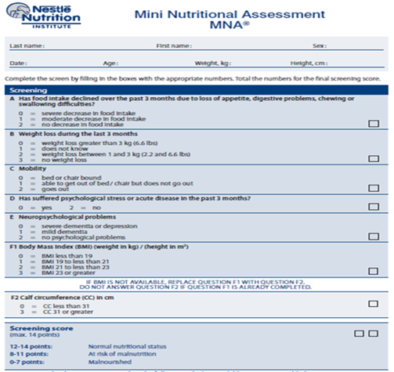

Slide 30
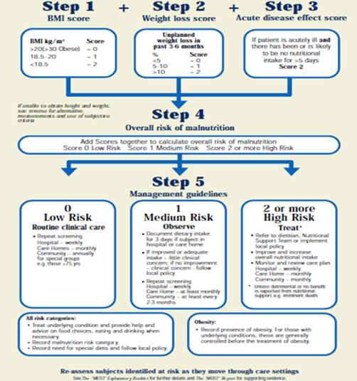

Slide 31
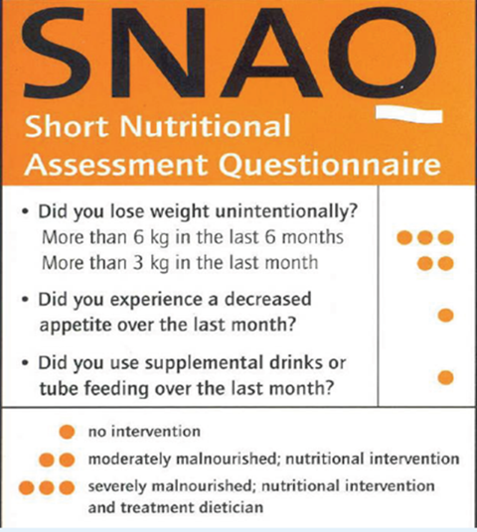

Slide 33
Assessment
Confirm malnutrition
All screening tools will have false positives= people who triggered risk but are not malnourished
Clarify processes → inflammation and/or intake as root causes of wasting and weight loss
Identify potential reasons for poor food intake e.g. nausea, dysphagia, self-feeding difficulties
Identify intervention modes, best approaches
Monitor intervention success – compare to a baseline
Keller, H.H. Aging Well with Nutrition. Second Edition. 2009

Slide 34
Nutritional Health status assessment
The nutritional heath status of any person is determined by the sum of certain measures
Anthropometric measurements
Biochemical measurements
Clinical
Dietary
Economic evaluation.

Slide 35
Assessment of these measurements put three people in three main categories
Desirable nutrition
Malnutrition
Under-nutrition
Overnutrition

Slide 36
Desirable Nutrition
Person is described to have a desirable nutrition status when;
The body tissues have enough nutrients to conduct normal functions
Excess stores are available when needed
This status can be achieved by a varied balanced diet

Slide 37
Under-nutrition
Occurs when:
The nutrient needs are higher the actual intake
Health status begins to decline.
Such nutrients are extremely needed in body cycles such as B vitamins in the GI, therefore they should be supplied in large quantities
Iron levels for women

Slide 38
Low levels of nutrient stores will affect both biochemical and clinical measures
Biochemical function may be reduced firstly by:
biochemical lesion
Stores of a nutrient is depleted which affect the concentration in the cells
This slows the metabolic process or even stop it

Slide 39
2. Subclinical
Disease or disorder that is present but not severe enough to produce signs and symptoms that can be detected or diagnosed
Example:
Concentration of hemoglobin in blood are lower than normal in blood, as a result of iron stores depletion

Slide 40
3. Clinical
Severe deficit in a nutrient with a development of signs and symptoms
Clinical signs: Skin, hair,..
Detected on physical examination
Example: Iron deficiency?

Slide 41
Over-nutrition
Results from a prolonged consumption of more nutrients than the body needs.
Short-term: few symptoms (GI disturbances)
Long-term: Toxic amounts→ serious problems (obesity) → serious diseases ( type-2 diabetes, cancers)

Slide 42
Generally, the gap between desirable intake and over intake is wide
However, this gap is narrower for certain nutrients, such as: Vitamin A, calcium, iron or copper.
Supplements ?

Slide 43
How to measure nutritional status?
Can be done by a physician or a trained dietitian
Analyzing background status
Evaluate ABCDEs

Slide 44
Analyzing Background Factors
Family history
Medical history
Social history
Education level

Slide 45
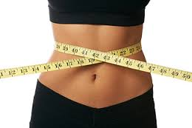
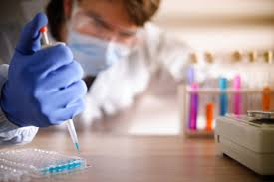
Evaluating the ABCDEs
Anthropometric assessment
This includes the measures of weight, height, weight changes, skin folds, body circumferences
Biochemical assessment
Nutrients or nutrients by-products in blood or urine..

Slide 46
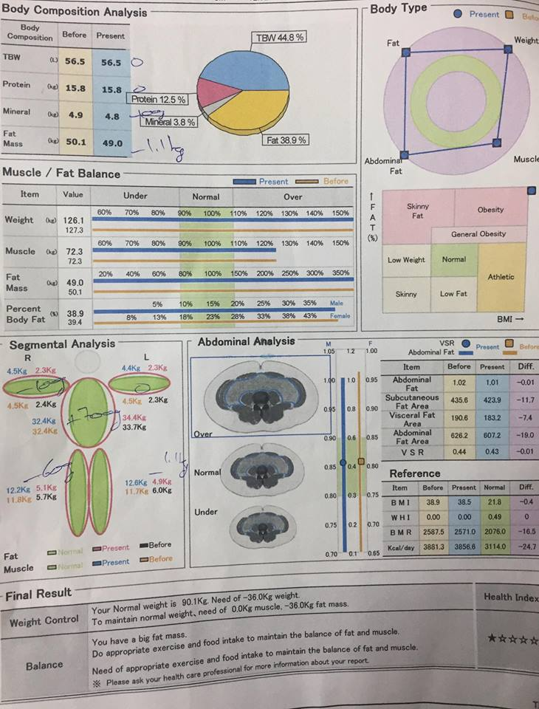

Slide 47
Clinical assessment
Health professional detect any physical signs for a diet-related diseases (odema, ascitis, brittle hair)
Dietary assessment
Assess person’s diet … later in details
Economic status
Could also be detected in the background assessment

Slide 48
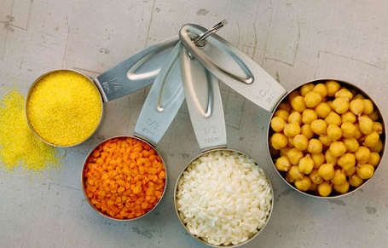
Dietary assessment
Measure the usual intake
Not very reliable as the dietary intake vary from day to another
Not all nutrients are assessed correctly

Slide 49
Dietary assessment methods
Recording methods
Weighed food intake record.
Unweighed food intake record.
Recall methods
Actual intake, from a 24-hour recall or recall of more than one day.
Usual intake, via a food intake questionnaire

Slide 50
Recording methods
Weighed food intake record
The food items are weighted using a provided scale (sensitive to small weights)
Then it is recorded on a special notebook
For a period of 3-7 days
Patients will be taught how to deal with out-home meals
All records are entered into computer for results

Slide 51
Unweighed food intake record
Same methods of weighted food record
But without weighing food or drinks
Intake is described with house-hold measures
Example: Table spoon, tea spoon, cups,..
Errors: deciding portion sizes (over/under estimation) → photographic method (suitable for people who lack writing skills)

Slide 52
Recall methods
Actual intake
24-hour recall: asking the patient to recall all he/she consumed in the past 24 hours
Simple, quick, no effort needed from the patients
Periods longer than 24 hours may be impossible

Slide 53
Usual intake
Questionnaire
Food-frequency questionnaire (FFQ): includes a list of food and drinks that are usually consumed.
Patients should record how often they consume each of the mentioned food or drinks
Paper, computer or web forms

