Slide 1
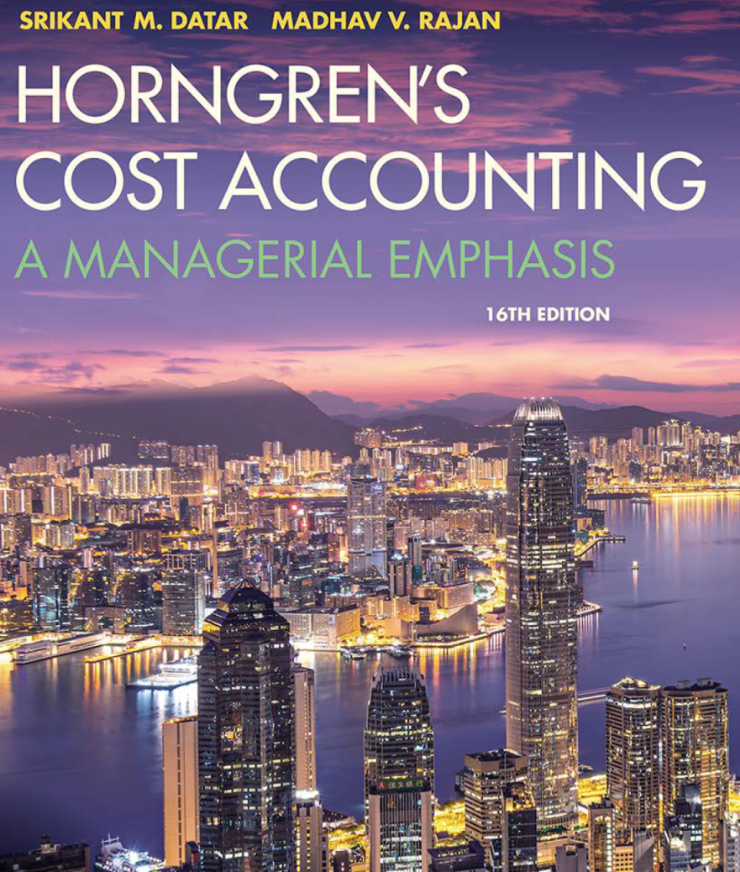
Cost Accounting
Sixteenth Edition
Chapter 2
An Introduction to Cost Terms and Purposes
Copyright © 2018, 2016, 2015 Pearson Education, Inc. All Rights Reserved.

Slide 2
Learning Objectives
2.1 Define and illustrate a cost object
2.2 Distinguish between direct costs and indirect costs
2.3 Explain variable costs and fixed costs
2.4 Interpret unit costs cautiously
2.5 Distinguish inventoriable costs from period costs
Notes:
What does the word cost mean to you?
In this chapter, we’ll distinguish among various types of costs and will explore the following objectives:
2.1 Define and illustrate a cost object
2.2 Distinguish between direct costs and indirect costs
2.3 Explain variable costs and fixed costs
2.4 Interpret unit costs cautiously
2.5 Distinguish inventoriable costs from period costs
2.6 Illustrate the flow of inventoriable and period costs
2.7 Explain why product costs are computed in different ways for different purposes
2.8 Describe a framework for cost accounting and cost management.

Slide 3
Basic Cost Terminology (1 of 2)
Cost – a sacrificed or forgone resource to achieve a specific objective.
Actual cost – a cost that has occurred
Budgeted cost – a predicted cost
Cost object – anything for which a cost measurement is desired
How does a company decide the cost of a cost object?
Notes:
Here we see some basic cost terms and their definitions.
Managers use cost information in two main ways: when MAKING decisions and when IMPLEMENTING decisions.

Slide 4
Basic Cost Terminology (2 of 2)
Cost Accumulation – the collection of cost data in an organized way by means of an accounting system
Cost Assignment – a general term that encompasses the gathering of accumulated costs to a cost object in two ways:
Tracing costs with a direct relationship to the cost object, and
Allocating accumulated costs with an indirect relationship to a cost object.
Notes:
Here, we have some additional terminology:
Cost accumulation—a collection of cost data in an organized way by means of an accounting system
Cost assignment—a general term that encompasses the gathering of accumulated costs to a cost object in two ways:
Tracing accumulated costs with a direct relationship to the cost object and
Allocating accumulated costs with an indirect relationship to a cost object

Slide 5
Direct and Indirect Costs
Direct costs can be conveniently and economically traced (tracked) to a cost object.
Indirect costs cannot be conveniently or economically traced (tracked) to a cost object. Instead of being traced, these costs are allocated to a cost object in a rational and systematic manner.
Notes:
One way that we differentiate between different kinds of costs is to identify them as direct or indirect.
Direct costs can be conveniently and economically traced (tracked) to a cost object.
Indirect costs cannot be conveniently or economically traced (tracked) to a cost object. Instead of being traced, these costs are allocated to a cost object in a rational and systematic manner.
The salary of a plant administrator at BMW, as an example, is an indirect cost of a particular automobile because unlike the steel or tires used, it is virtually impossible to trace plant administration costs to a particular car line.

Slide 6
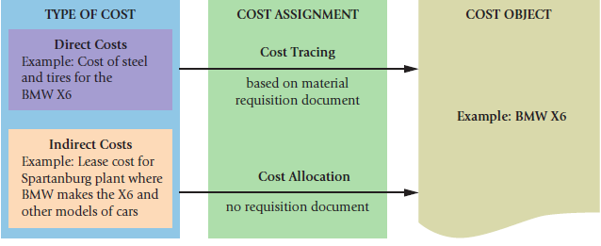
Cost Assignment to a Cost Object (BMW Example)
Notes:
Going back to our X6 BMW example, we see here an illustration of how costs for that line would be collected to the cost object.
If the BMW X6 is our cost object, the direct costs can be traced but the indirect costs must be allocated. Added together, we’ll obtain total costs for the cost object.
Exhibit 2-2 page 31.

Slide 7
Cost Allocation Challenges
Direct Costs
Material (steel or tires for a car, as an example)
Labor (Assembly line wages)
Indirect Costs
Electricity
Rent
Property taxes
Plant administration expenses
Notes:
To get a better understanding of the types of items that fit into each type of cost (direct or indirect), we present some examples on this slide.
One way to think about this is that association between the direct costs and the specific request for those items in the production process. We need 4 tires and x lbs of steel for each car, but we don’t requisition some number of hours of administration time or rent for each car or for the line.
Managers are much more confident about the accuracy of the direct costs of cost objects, such as the cost of steel and tires of the X6, because these costs can be easily traced to the cost object. Indirect costs are a different story. Some indirect costs can be assigned to cost objects with reasonable accuracy. Others are more difficult.

Slide 8
Factors Affecting Direct/Indirect Cost Classifications.
The materiality of the cost in question.
The available information-gathering technology.
Design of operations.
NOTE: a specific cost may be both a direct cost of one cost object and an indirect cost of another cost object.
The direct/indirect classification depends on the choice of the cost object.
Notes:
A few factors affect the direct/indirect cost classification:
The materiality of the cost in question (the smaller the cost, the less likely it will be economically feasible to trace the cost)
The available information-gathering technology (technology makes it possible to consider more and more costs as direct)
Design of operations (if parts of a facility are dedicated to a particular cost object such as a specific product or a particular customer, we are generally able to classify more costs as direct)
A specific cost may be a direct cost for one cost object and an indirect cost for another.

Slide 9
Cost Behavior Patterns: Variable Costs And Fixed Costs – (1 of 2)
Variable costs change, in total, in proportion to changes in the related level of activity or volume of output produced.
Fixed costs remain unchanged, in total, for a given time period, despite changes in the related level of activity or volume of output produced.
Costs are fixed or variable for a specific activity and/or for a given time period.
Notes:
Cost behavior defines how costs change. Variable costs will change in total with a change of activity. Fixed costs will change per unit with a change of activity.
Costs are fixed or variable for a specific activity and/or for a given time period.

Slide 10
Cost Behavior Patterns: Variable Costs and Fixed Costs – (2 of 2)
Variable costs are constant on a per-unit basis. If a product takes 5 pounds of material each, it stays the same per unit regardless if one, ten or a thousand units are produced.
Fixed costs per unit change inversely with the level of production. As more units are produced, the same total fixed cost is spread over more and more units, reducing the cost per unit.
Notes:
When considering variable and fixed costs, it is very important to know if you are looking at the costs IN TOTAL or PER UNIT.
Variable costs – change in total in proportion to changes in the related level of activity or volume of output produced.
Fixed costs – remain unchanged in total, for a given time period, despite changes in the related level of activity or volume of output produced.

Slide 11
Cost Behavior Patterns: Variable Costs And Fixed Costs – Production of X6s
Notes:
Cost behavior defines how costs change. Variable costs will change in total with a change of activity. Fixed costs will change per unit with a change of activity.
Costs are fixed or variable for a specific activity and/or for a given time period.

Slide 12
Cost Behavior Summarized
- | TOTAL DOLLARS | COST PER UNIT
VARIABLE COSTS | Change in proportion with output (more output = more cost) | Unchanged in relation to output
FIXED COSTS | Unchanged in relation to output (within the relevant range) | Change inversely with output (more output = lower cost per unit)
Cost per unit = Total cost / number of units produced
Notes:
In this chart, we have a summary of the way our costs change in total or per unit.
Variable cost TOTAL DOLLARS change in proportion with output but remain unchanged PER UNIT.
Fixed cost TOTAL DOLLARS remain unchanged in relation to output but change INVERSELY per unit.

Slide 13
Graphs of variable and fixed costs
PANEL A: Variable Costs of Steering Wheels at $60 per BMW X6 Assembled
PANEL B: Supervision Costs for the BMW X6 Assembly Line (in Millions)
Notes:
In these charts, we see the graphs for variable and fixed costs using the number of steering wheels for the BMW X6.
Panel A shows a graph of the total variable cost of steering wheels. The cost begins at zero because if we make no X6s, we’ll incur no cost for the steering wheels.
Fixed Costs are presented in Panel B where we have a line across at the $2,000,000 mark. The Annual total fixed supervision costs for the X6 are that amount and will be that amount whether we assemble zero, 20,000, 40,000 or 60,000 cars.
Of course, over time, that may change. At a consistent assembly rate of zero, we may eliminate the supervisor position. At an assembly rate of greater than 60,000., we may need a second supervisory position.
Exhibit 2-3 page 34.

Slide 14
Other Cost Concepts
Mixed costs have both fixed and variable elements
Cost driver – a variable, such as the level of activity or volume, that causally affects costs over a given time span.
Relevant range – the band or range of normal activity level (or volume) in which there is a specific relationship between the level of activity (or volume) and the cost in question.
Fixed costs are considered fixed only within the relevant range.
Notes:
In this slide, we consider a few additional concepts.
Mixed costs – contain both fixed and variable elements
A cost driver is a variable, such as the level of activity or volume, that causally affect costs over time.
The relevant range is the band or range of normal activity within which the fixed costs would not change.
The idea of the relevant range is that at some point of increased production, fixed costs will increase.

Slide 15
Multiple Classifications of Costs
Costs may be classified as:
Direct/Indirect, and
Variable/Fixed
These multiple classifications give rise to important cost combinations:
Direct and variable
Direct and fixed
Indirect and variable
Indirect and fixed
Notes:
We have introduced two major classifications of costs: direct and indirect; variable and fixed.
As a result, we can have the following combinations of costs:
Direct and variable
Direct and fixed
Indirect and variable
Indirect and fixed

Slide 16
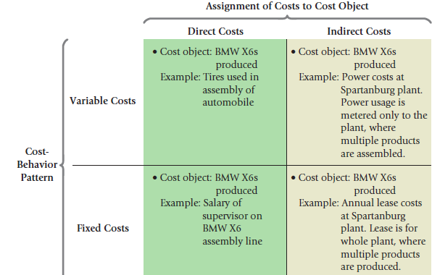
Examples of the Multiple Classifications Of Costs
Notes:
Once again using the BMW X6 as an example, we see here examples of the various combinations that can occur for direct/indirect and variable/fixed costs.
Exhibit 2-5, page 37.

Slide 17
Use Unit Costs Cautiously
Although unit costs are regularly used in financial reports and for making product mix and pricing decisions, managers should think in terms of total costs rather than unit costs for many decisions.
Notes:
We’ve been discussing how variable costs and fixed costs differ in terms of their unit costs. For this reason, unit costs should be used cautiously. Because unit costs change with a different level of output or volume, it may be more prudent to base decisions on a total dollar basis.

Slide 18
Use Unit Costs Cautiously
Notes:
We’ve been discussing how variable costs and fixed costs differ in terms of their unit costs. For this reason, unit costs should be used cautiously. Because unit costs change with a different level of output or volume, it may be more prudent to base decisions on a total dollar basis.

Slide 19
Different Types of Firms
Manufacturing-sector companies purchase materials and components and convert them into various finished goods.
Merchandising-sector companies purchase and then sell tangible products without changing their basic form.
Service-sector companies provide services (intangible products) like legal advice or audits.
Notes:
Cost accounting is used for all types of firms including:
Manufacturing-sector companies who purchase materials and components and convert them into various finished goods
Merchandising-sector companies who purchase and then sell tangible products without changing their basic form
Service-sector companies who provide services (intangible products) like legal advice or audits

Slide 20
Types of Inventory
Direct materials – resources in-stock and available for use
Work-in-process (or progress) – goods partially worked on but not yet completed, often abbreviated as WIP
Finished goods – goods completed but not yet sold
Note: Merchandising-sector companies hold only one type of inventory: merchandise inventory
Notes:
Manufacturing-sector companies purchase materials and components and convert them into finished goods. These companies typically have one or more of the following three types of inventory.
Direct materials – resources in-stock and available for use
Work-in-process (or progress) – products started but not yet completed, often abbreviated as WIP
Finished goods – products completed and ready for sale
Note: Merchandising-sector companies hold only one type of inventory: merchandise inventory

Slide 21
Commonly Used Classifications of Manufacturing Costs
Direct materials – acquisition costs of all material that will become part of the cost object.
Direct labor – compensation of all manufacturing labor that can be traced to the cost object.
Indirect manufacturing – all manufacturing costs that are related to the cost object but cannot be traced to that cost object in an economically feasible way.
Notes:
Three terms are commonly used when describing manufacturing costs. These terms build on the direct versus indirect cost distinctions we discussed ealier.
Indirect manufacturing costs are also referred to as manufacturing overhead costs or factory overhead costs.

