Slide 1
An-Najah National University
Faculty of Medicine
Department of Physiology
Anatomy and Physiology 1
7102101
Instructor: Heba Salah
Chapter 5:
The Nervous System
Part 5: Central Nervous System: Diencephalon, and Cerebellum

Slide 2
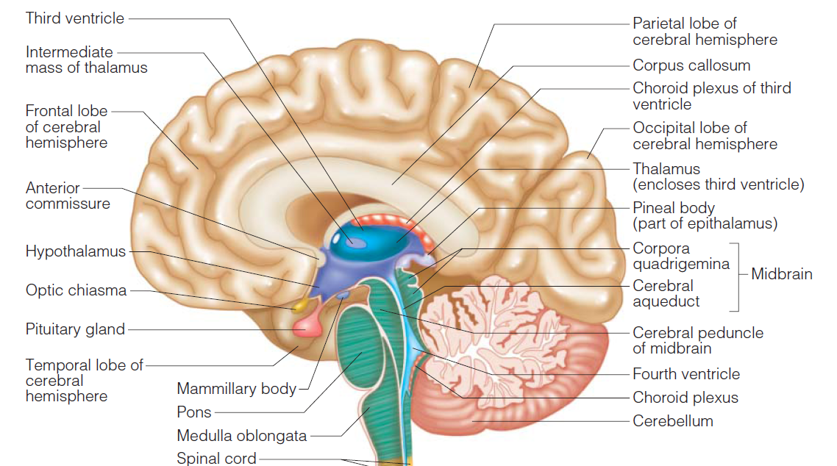
Diencephalon
Sits on top of the brain stem
Made of three parts:
Thalamus
Hypothalamus
Epithalamus

Slide 3
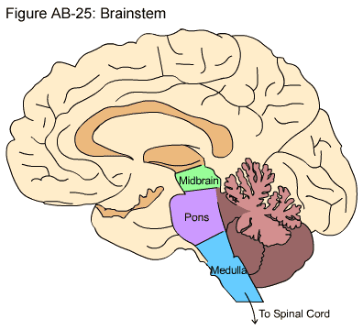
Brain Stem
Attaches to the spinal cord
Parts of the brain stem:
Midbrain
Pons
Medulla oblongata

Slide 4
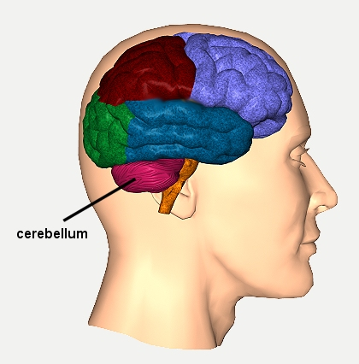
Cerebellum
Two hemispheres with convoluted surfaces
Provides involuntary coordination of body movements

