Slide 1
Energy Science and Technology: Solar Energy
2018/2019

Slide 2
Objectives
Understand the uses of Solar Energy in
Heating and cooling
Generating electricity
Understand the different mechanisms of concentrating solar energy

Slide 3
Introduction
http://www.youtube.com/watch?v=NDZzAIcCQLQ
http://www.youtube.com/watch?v=4uPVZUTLAvA
Almost all of our energy is from solar energy
(through nuclear)

Slide 4
Solar Energy
Uses of solar energy
Heating and cooling
(Chapter 2)
Generate electricity
Directly
(Photovoltaics)
(Chapter 3)
Indirectly
(Concentrating)
(Chapter 2)
Chapter 2: Solar thermal energy
Chapter 3: Solar Photovoltaics

Slide 5
Solar Thermal Energy
Solar Thermal Systems
Passive
Active
Does not include mechanical equipment
Includes mechanical equipment (pumps, fans, etc)
Daylighting
Solar Thermal Engines
Active systems with concentrators
Making best use of natural light

Slide 6
The nature and availability of solar radiation

Slide 7
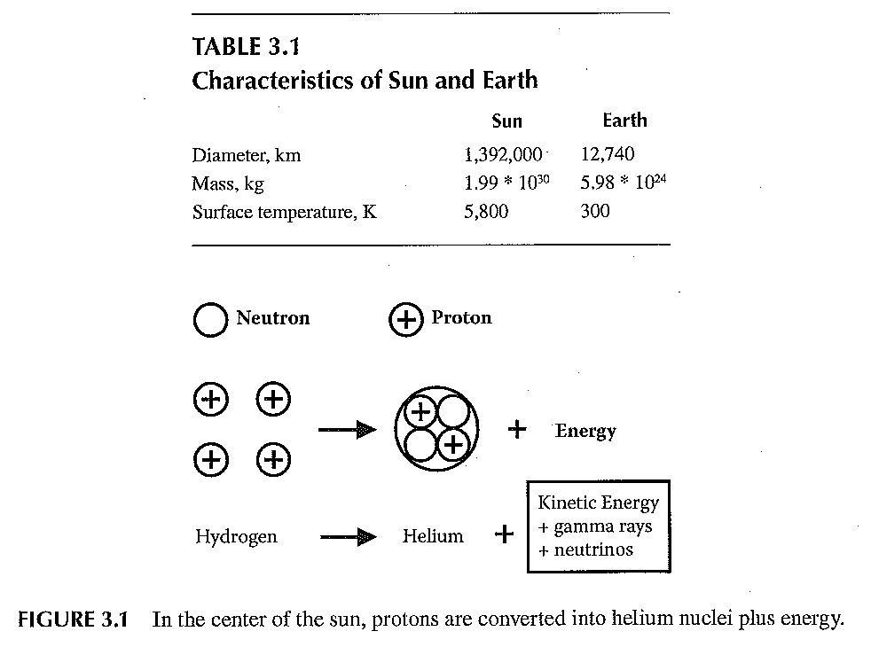
Characteristics
Introduction to Renewable Energy, by Vaughn Nelson, CRC Press Taylor & Francis Group, Boca, Raton, London, New York, 2011

Slide 8
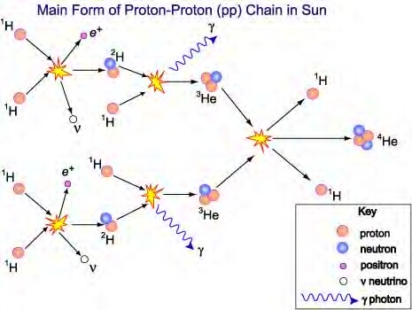
The Main Reactions
http://m.teachastronomy.com/astropedia/article/Nuclear-Reactions-in-the-Sun

Slide 9
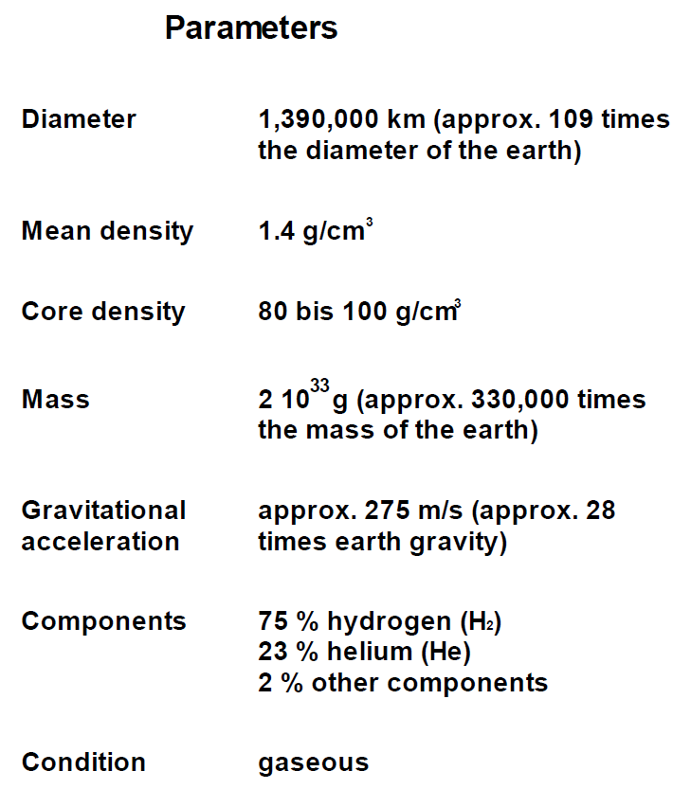
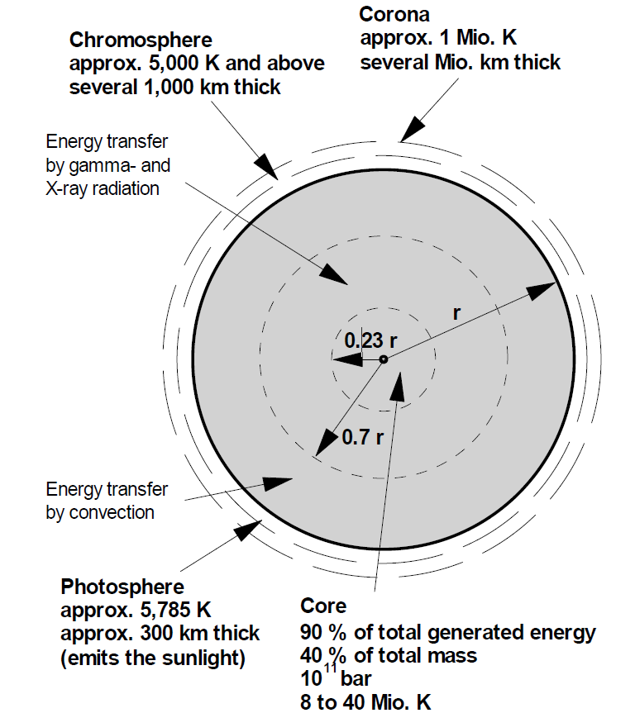
Introduction: Solar Energy
The sun is the central body of our planetary system; and is the star closest to the earth
Renewable Energy, by Martin Kaltschmitt . Wolfgang Streicher, and Andreas Wiese, Springer- USA 2007

Slide 10
Parameters
Nucleus has temperatures of approximately 15x10⁹ K.
Energy is released by nuclear fusion where hydrogen is melted to helium. The resulting mass loss (approximately 5x10⁹ Kg/s) is converted into energy E.
Einstein: Energy is calculated by multiplying mass m and the square of the speed of light c:
E=mc²
Energy is released in the form of electromagnetic radiation

Slide 11
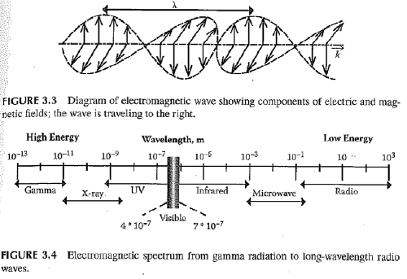
Electromagnetic Radiation
Electromagnetic radiation mainly released by the photosphere covers the entire frequency from short-wave to long-wave radiation
Introduction to Renewable Energy, by Vaughn Nelson, CRC Press Taylor & Francis Group, Boca, Raton, London, New York, 2011

Slide 12
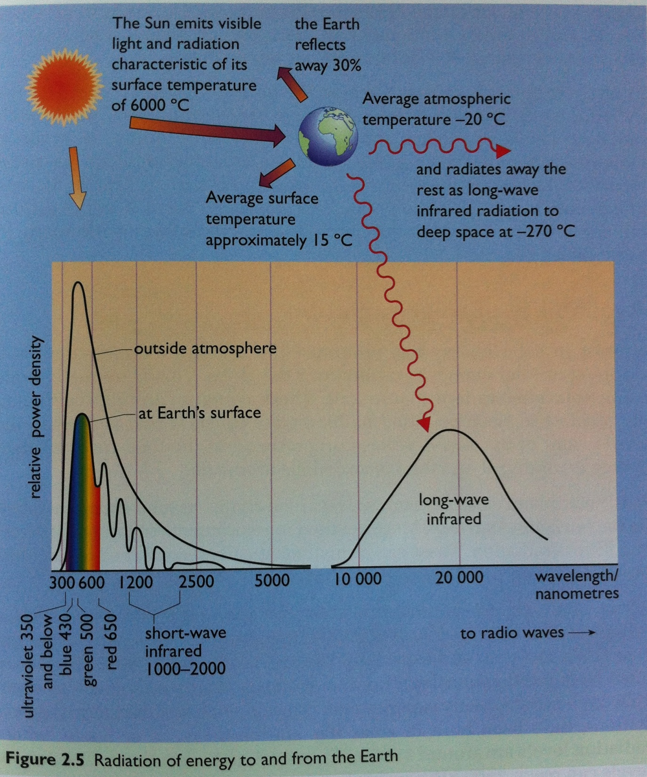
Radiation from the Photosphere

Slide 13
Radiant Flux Density
The radiant flux density of the sun, M_{S}, is approximately 63.5x10⁶ W/m²
The radiant flux density of the sun decreases with the square of the distance travelled
Radiant flux density at the outer rim of the earth atmosphere E_{SC} can be calculated according to:

Slide 14
Radiant Flux Density calculation
Diameter of sun d_{S} is assumed up to photosphere (approx.1.39x10⁹ m)
Mean distance between sun and earth (L_{ES}) is approx. 1.5 10¹¹ m
The mean radiant flux density is approx. 1,370 W/m² calculated at the top rim of the earth atmosphere. This mean value is called the solar constant.
Why does the radiant flux density change throughout the year?

Slide 15
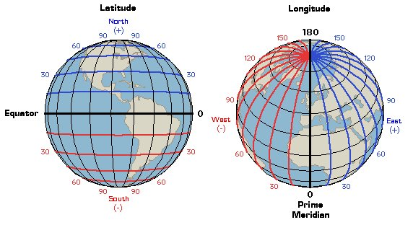
Position – On Earth
Longitude – from North to South, zero at Greenwich
Latitude – from East to West, zero at the equator
http://geographyworldonline.com/tutorial/latitudelongitude.jpg

Slide 16
Position – Of the Sun
Altitude – between sun and horizon
Azimuth – between north and the projection of line from sun to Earth
Introduction to Renewable Energy, by Vaughn Nelson, CRC Press Taylor & Francis Group, Boca, Raton, London, New York, 2011

Slide 17
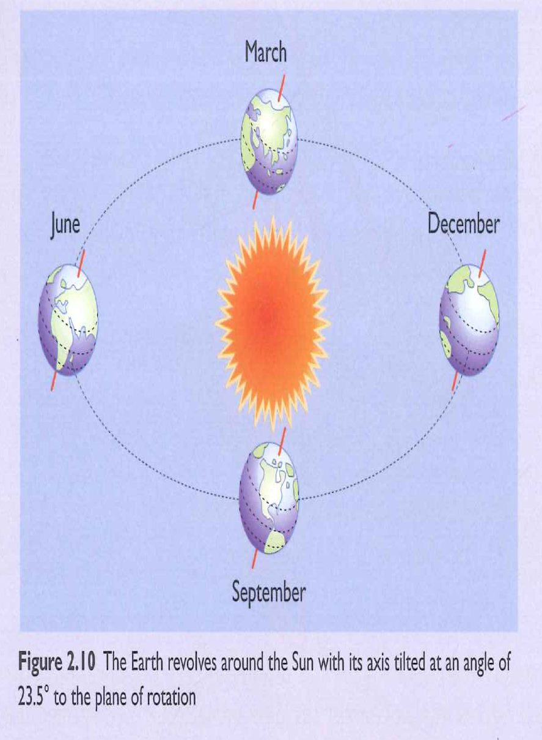
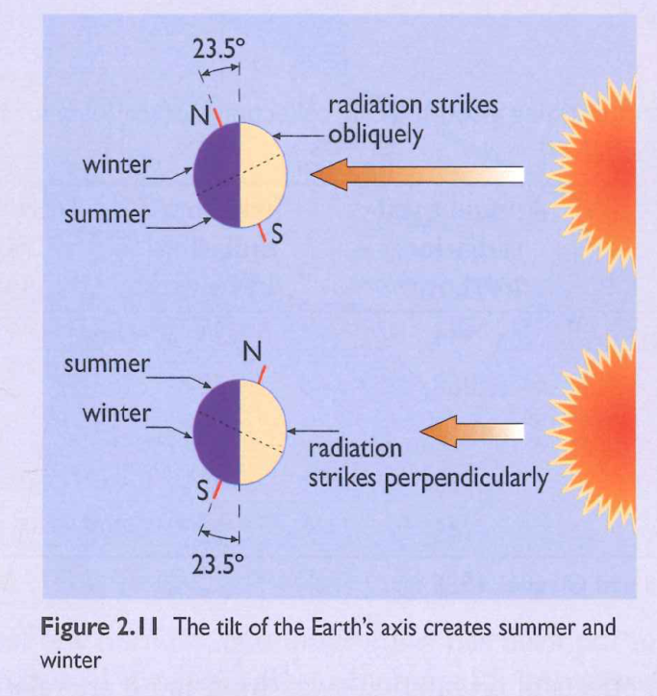
Seasonal Variation
Caused by the elliptical orbit, where earth moves around the sun during the course of one year
What happens in the North Pole in summer and winter?

Slide 18
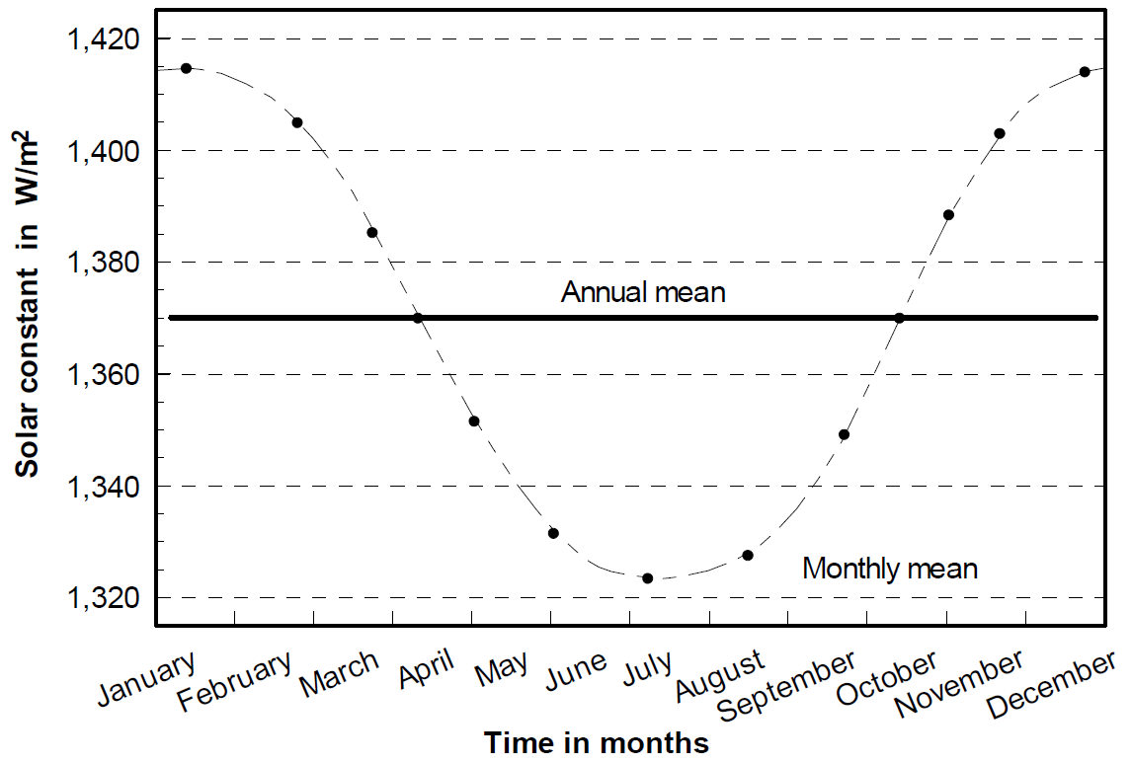
Yearly intensities
Relative distance variation leads to fluctuation in radiation incident on the atmospheric rim
The solar constant reaches its maximum in January at almost 1,420 W/m², due to reaching the shortest distance between the sun and the earth (Perihelion) on January.
The opposite takes place on July, when it reaches its minimum with approximately 1,330 W/m² (Aphelion).
Renewable Energy, by Martin Kaltschmitt . Wolfgang Streicher, and Andreas Wiese, Springer- USA 2007

Slide 19
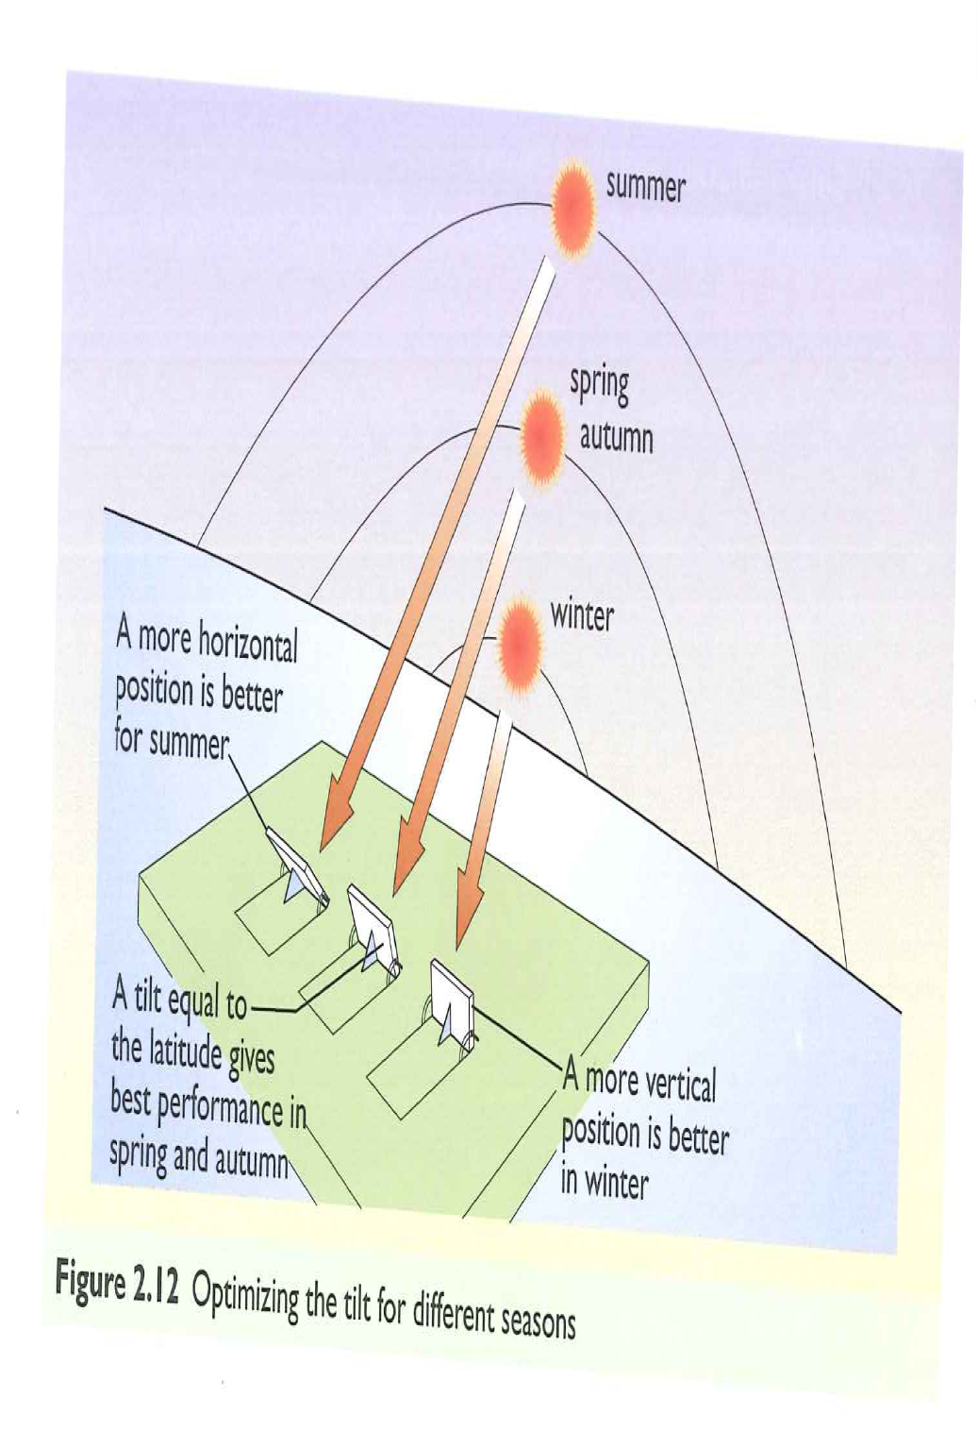
Optimizing the Tilt
Tilt angle < latitude (in summer)
Tilt angle = latitude (in spring and autumn)
Tilt angle > latitude (in winter)
To maximize solar collection if you are on the northern hemisphere.

Slide 20
Insolation
Solar radiation at the surface of the earth
Units: energy/sq. meter or power/sq. meter
Insolation
Direct
Perpendicular to the sun
Diffuse
Scattered from the atmosphere or reflected from objects on the surface

Slide 21
Glazing
Before discussing solar heating and cooling, we must study glazing
Glazing
Transparent material used for windows
Covering that transmits solar energy
Material can be glass (clear/coated/tinted) or plastics.

Slide 22
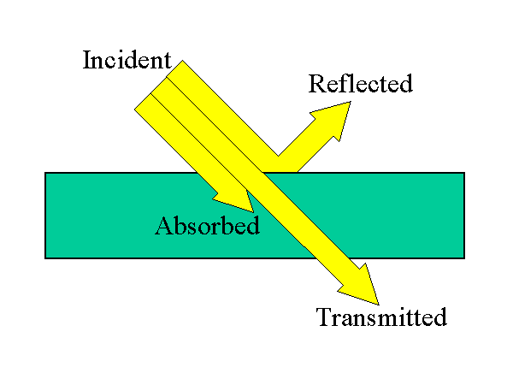
Incident light
As light is incident on a material, it is either:
Absorbed (α), or
Transmitted (τ), or
Reflected (ρ)

Slide 23
Windows
Incident light is either transmitted, reflected, or absorbed
Absorbed light is eventually reradiated
Transmittance depends of glazing material and angle of incidence
Windows can be single or multiple layer

Slide 24
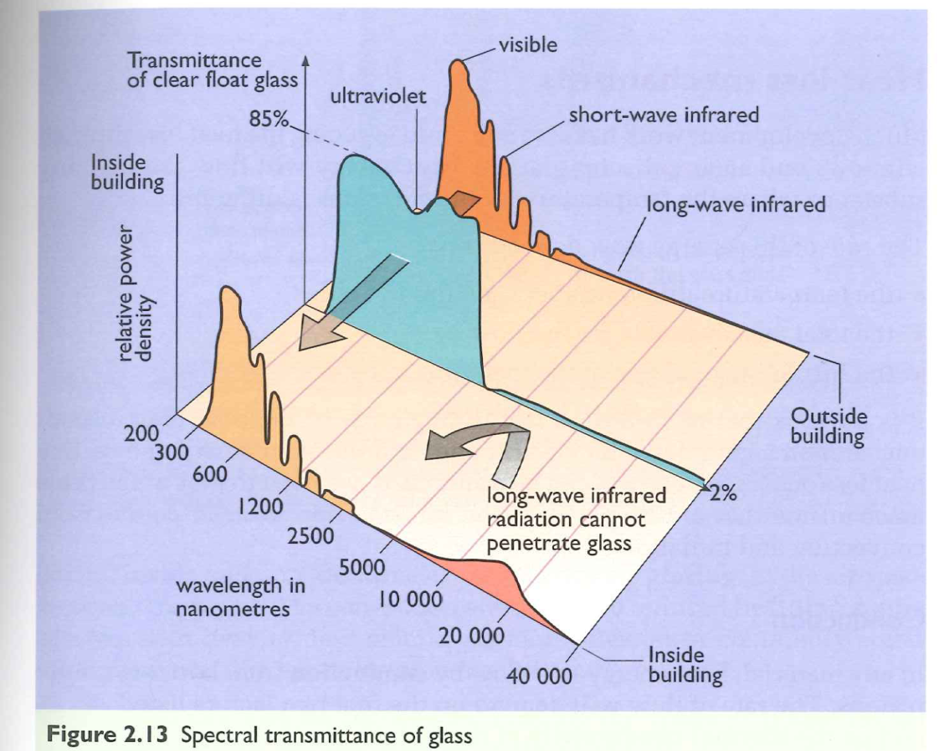
The Magic of Glass
Transparent to visible light and short-wave infrared radiation
Opaque to long-wave infrared radiation

Slide 25
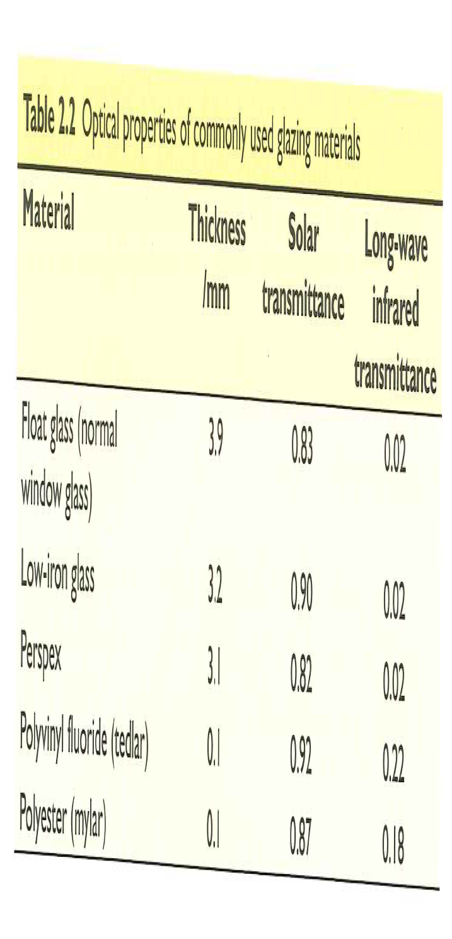
Properties of Glazing Materials

Slide 26
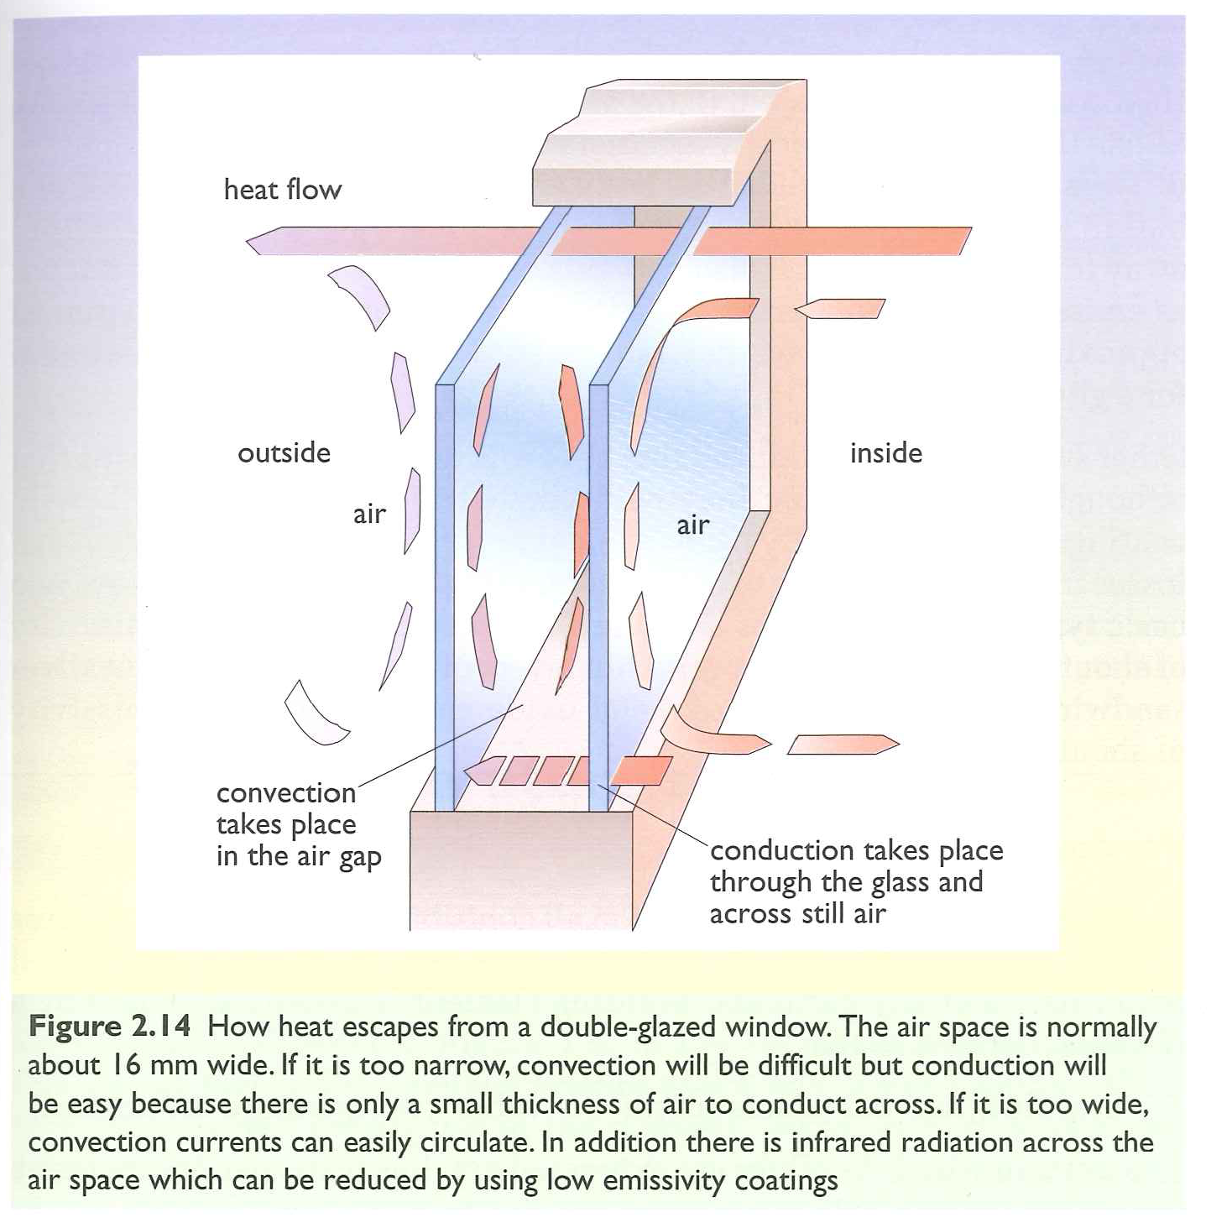
Heat Loss Mechanisms

Slide 27
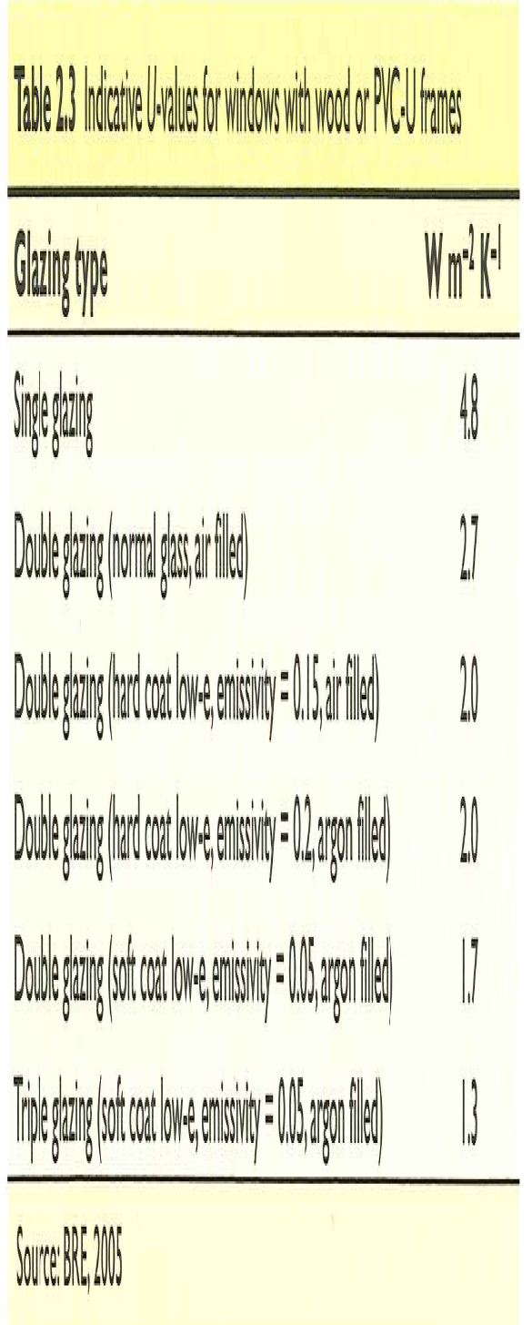
Windows U-value
Heat flow rate per square meter = U-value x temperature difference
How is this related to the equations we took before on heat transfer?

Slide 28
Solar Heating
The amount of solar energy (insolation) that comes into a building depends on:
Window
Size
Orientation (normal, vertical horizontal)
Glazing material
Shading
Time of year
Location
Percentage sunshine (clouds, haze, clear)

